Slide 1
Chapter 3 Properties of Steams
Introduction :
Vapour:-
Under the normal conditions, fluids which can exist in a liquid as well as gaseous state are known as vapours.
Example as a steam as a vapour phase of water, ammonia, freon etc.
They do not obey gas equation and ideal gas law like Boyle’s law, Charles law etc.
Under the certain conditions they are used for the approximate calculations.

Slide 2
Pure Substance:-
It is one which has homogeneous molecular structure and invariable chemical composition. Pure substance can exist in any of the three phase such as solid, liquid, and gaseous state,
it may exist in more than one phase.
But its molecular structure and chemical composition is always remain same at all conditions such as water.

Slide 3
Air is not pure substance since, Because at very low temperature gases presents in the air like as N2,O2 liquefies at their boiling temperatures and chemical composition and molecular structure of air changes.

Slide 4
Steam Formation:-
Consider 1 kg of the ice at 15 ˚C and the standard atmospheric pressure .
Heat is now added at the constant pressure. Various states passes through by the system is plotted on the T-h diagram.

Slide 5
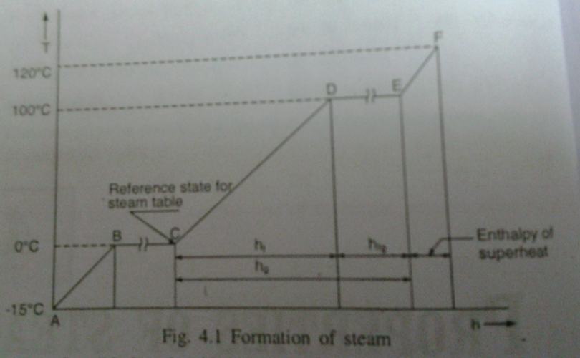

Slide 6
A-B:- Sensible heat is added to ice and its temperature will increase up to melting temperature 0˚C.
B-C:- Latent heat is added and ice starts melting at its melting temperature 0˚C.
Ice converts into water from and at 0˚C.
This process is known as “latent heat of fusion of ice.”
C-D:- On the further addition of heat, water temperature will increase up to its saturation temperature.
Point D is said to be saturated liquid state.

Slide 7
D-E :- During this process temperature remain constant and latent heat is added.
At point D water starts boiling and it continues up to point E.
At point E boiling ends.
Amount of the heat added during this process is called “latent heat of vaporization”.

Slide 8
E-F:- On the further addition of heat steam temperature will increase.
Steam having temperature higher than its saturation temperature at particular pressure is called superheated steam.
Steam having state beyond point E is superheated steam.

Slide 9
Difference between temperature of superheated steam and its saturation temperature is called degree of superheat.
Heat difference between Tf and Te is called degree of superheat.

Slide 10
Enthalpy of Steam:-
From the First law of thermodynamics,
we know that heat added at the constant pressure is equal to enthalpy change of the substance.
Q = ΔU + W
Q = (U2-U1) + P (V2-V1)
Q = (U2 + PV2) - (U1 + PV1)
Q = (H2-H1)

Slide 11
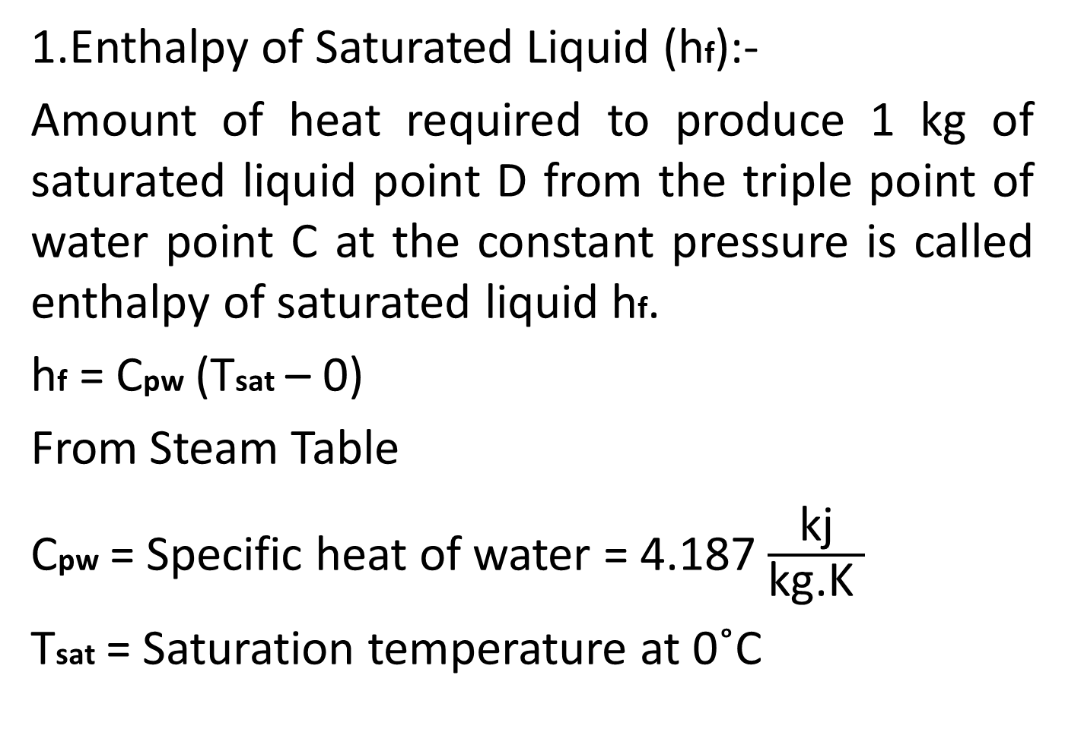
1.Enthalpy of Saturated Liquid (hf):-
Amount of heat required to produce 1 kg of saturated liquid point D from the triple point of water point C at the constant pressure is called enthalpy of saturated liquid hf.
hf = Cpw (Tsat – 0)
From Steam Table
Cpw = Specific heat of water = 4.187 $\frac{\text{kj}}{\text{kg}\text{.}\text{K} }$
Tsat = Saturation temperature at 0˚C

Slide 12
2.Enthalpy of Vaporization (hfg) :-
Amount of heat required to convert 1 kg of water from saturated liquid state point D to the saturated vapour state point E is called enthalpy of the vaporization (hfg).
So that hE- hD is known as enthalpy of vaporization.

Slide 13
3.Enthalpy of the Dry Saturated Steam:-
Amount of heat required to produce 1 kg of saturated vapour point E from triple point of water point C is called enthalpy of the dry saturated steam (hg).
So that hg = hf + hfg

Slide 14
4.Enthalpy of superheated steam:-
Amount of heat is added to dry saturated steam, it will become superheated.
Amount of heat required to produce 1 kg of superheated steam (point F) from reference state point C is called enthalpy of superheated steam.
We can also write that hsup = hg + Cps(Tsup -Tsat)

Slide 15
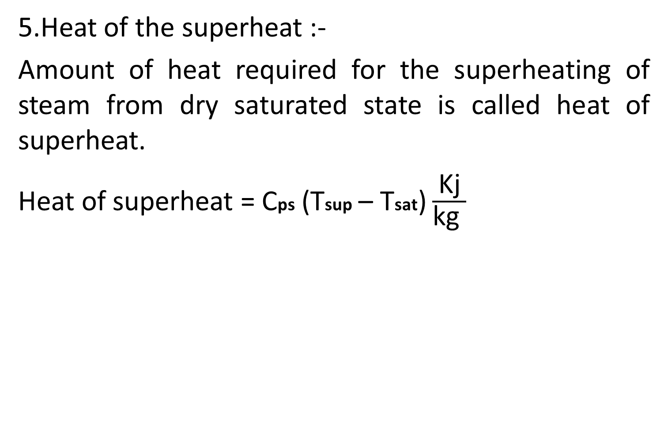
5.Heat of the superheat :-
Amount of heat required for the superheating of steam from dry saturated state is called heat of superheat.
Heat of superheat = Cps (Tsup – Tsat) $\frac{\text{Kj}}{\text{kg} }$

Slide 16
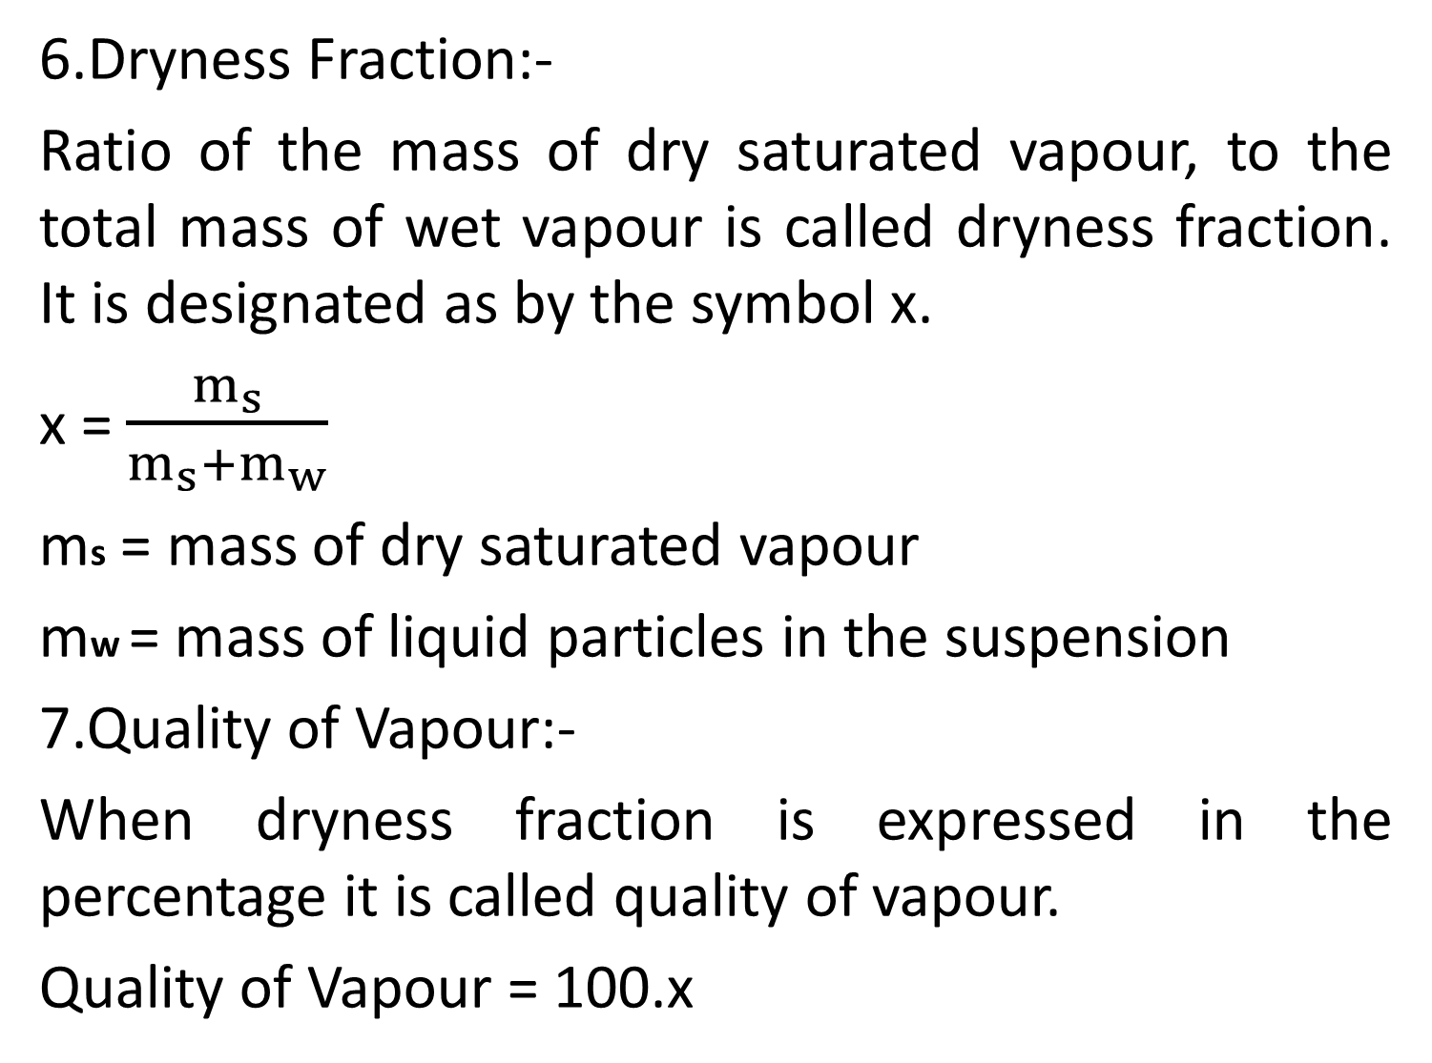
6.Dryness Fraction:-
Ratio of the mass of dry saturated vapour, to the total mass of wet vapour is called dryness fraction. It is designated as by the symbol x.
x = $\frac{m_{s}}{m_{s}+m_{w}}$
ms = mass of dry saturated vapour
mw = mass of liquid particles in the suspension
7.Quality of Vapour:-
When dryness fraction is expressed in the percentage it is called quality of vapour.
Quality of Vapour = 100.x

Slide 17
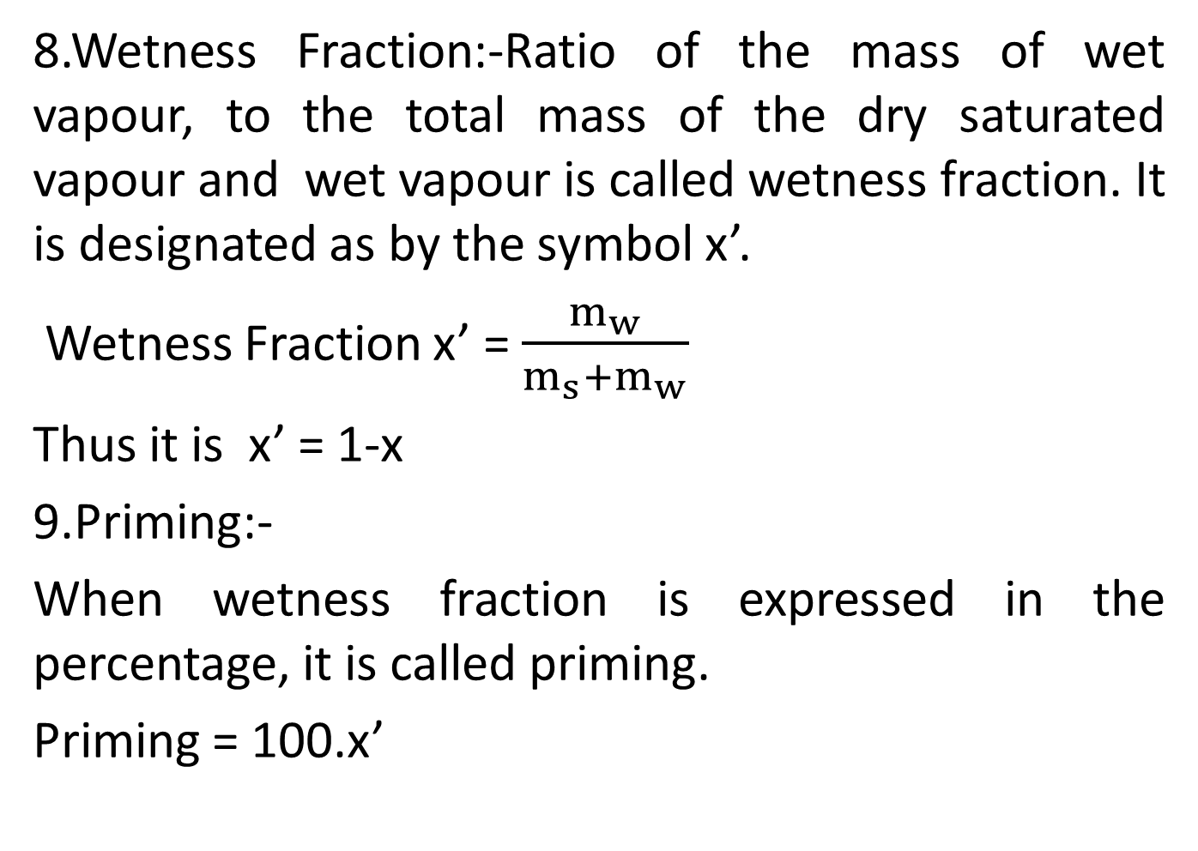
8.Wetness Fraction:-Ratio of the mass of wet vapour, to the total mass of the dry saturated vapour and wet vapour is called wetness fraction. It is designated as by the symbol x’.
Wetness Fraction x’ = $\frac{m_{w}}{m_{s}+m_{w}}$
Thus it is x’ = 1-x
9.Priming:-
When wetness fraction is expressed in the percentage, it is called priming.
Priming = 100.x’

Slide 18
10.Enthalpy of Wet Vapour (h):-
One kg of wet vapour having dryness fraction x contains (x kg of dry saturated steam at the saturation temperature (Tsat)) and ((1-x) kg of liquid particles at the saturation temperature).
So enthalpy of 1 kg of wet vapour is equal to enthalpy of x kg of dry saturated vapour plus enthalpy of (1-x) kg of saturated liquid.

Slide 19
Hence h = (1-x).hf + x.hg
= (1-x) hf + x (hf + hfg)
= hf + x. hfg
Specific enthalpy of vaporization of wet vapour is equal to x.hfg

Slide 20
Types of Steams:-
Wet Steam:-
Specific volume of the wet steam can be written
as v = (1-x) vf + x. vg
At low pressure the specific volume of saturated liquid is negligible compare to specific volume of saturated vapour,
hence generally the term of (1-x) vf is neglected.
v = x. vg

Slide 21
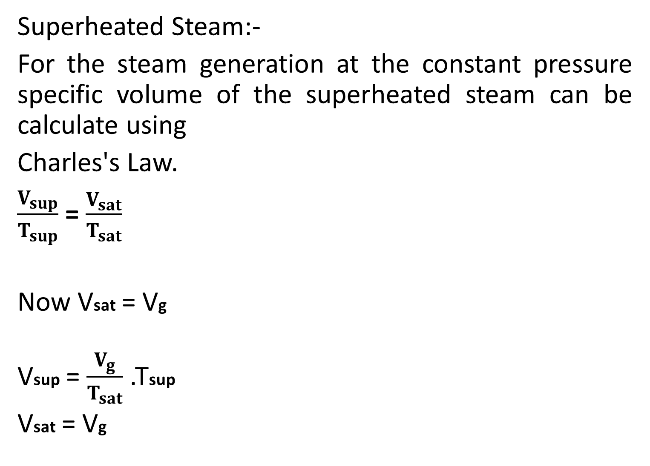
Superheated Steam:-
For the steam generation at the constant pressure specific volume of the superheated steam can be calculate using
Charles's Law.
$\frac{V_{sup}}{T_{sup}}$ = $\frac{V_{sat}}{T_{sat}}$
Now Vsat = Vg
Vsup = $\frac{V_{g}}{T_{sat}}$ .Tsup
Vsat = Vg

Slide 22
Steam Table:-
From experimental study various properties of steam like enthalpy, volume, internal energy are tabulated at the various pressure and temperature.
It may be pressure base or the temperature base.
It is tabulated for the specific properties.
Properties are tabulated from triple point of water to critical point of steam.
All the values are calculated with triple point of water as reference point means at 0˚C enthalpy, internal energy and the entropy is taken as zero.

Slide 23
Internal Energy:-
It can be calculate using definition of the enthalpy.
We have h = u + pv
u = h – pv
To calculate internal energy (u) of saturated, wet or superheated steam, appropriate value of the enthalpy (h) and the specific volume is to be substituted. Here pv is known as work done during evaporation.

Slide 24
Measurement of Dryness fraction
Four types of steam calorimeters are use to measure dryness fraction of steam.
Bucket Calorimeter
Separating Calorimeter
Throttling Calorimeter
Combined Calorimeter

Slide 25
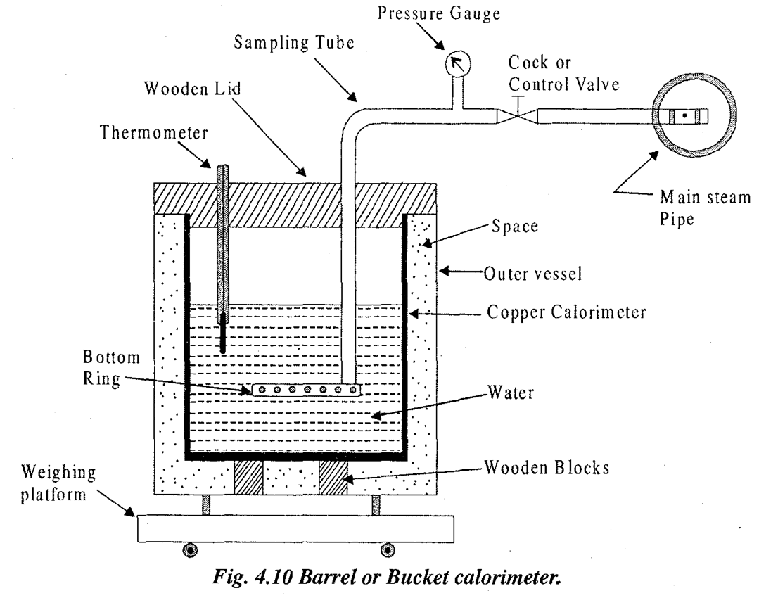
1. Bucket Calorimeter:-

Slide 26
CONSTRUCTION:
The apparatus shown in Figure consists of a copper calorimeter which is placed on wooden blocks in a vessel.
The vessel is large enough to provide an air space around the calorimeter.
This air space provides insulation to prevent heat loss.
The top cover is made of wood and it closes both the calorimeter and the vessel.
This cover has two holes.

Slide 27
Through one hole, the steam pipe is led into the calorimeter.
The steam is distributed in the water in the calorimeter by the holes in the bottom ring which is connected to the end of the steam pipe.
The thermometer is inserted from the second hole to measure the temperature of water in the calorimeter.

Slide 28
WORKING
The first step of the experiment is to measure the weight of calorimeter.
With the known value of specific heat of copper, the water equivalent of calorimeter is calculated.
Then necessary amount of water is taken, in the calorimeter and its initial temperature is noted.
The calorimeter is places in the vessel.
The top cover is placed in position and the steam pipe is connected to main steam pipe.

Slide 29
The steam comes in contact with water in the calorimeter when steam is passed through the water.
It condenses and gives out its entire enthalpy of evaporation (latent heat) and part of its sensible heat.
Due to heat transfer from steam to water in the calorimeter, the temperature of water increases.

Slide 30
Condensation of steam will increase the mass of water.
Sufficient quantity of steam should be blown in the calorimeter so that sufficient rise in temperature of water and thereby errors are reduced to minimum.
Afterwards the steam cock is closed.

Slide 31
The cock should be opened by such an amount that all the steam gets condensed in water and no steam bubbles escape out of water.
It is happens then the error may be introduce in calculation.

Slide 32
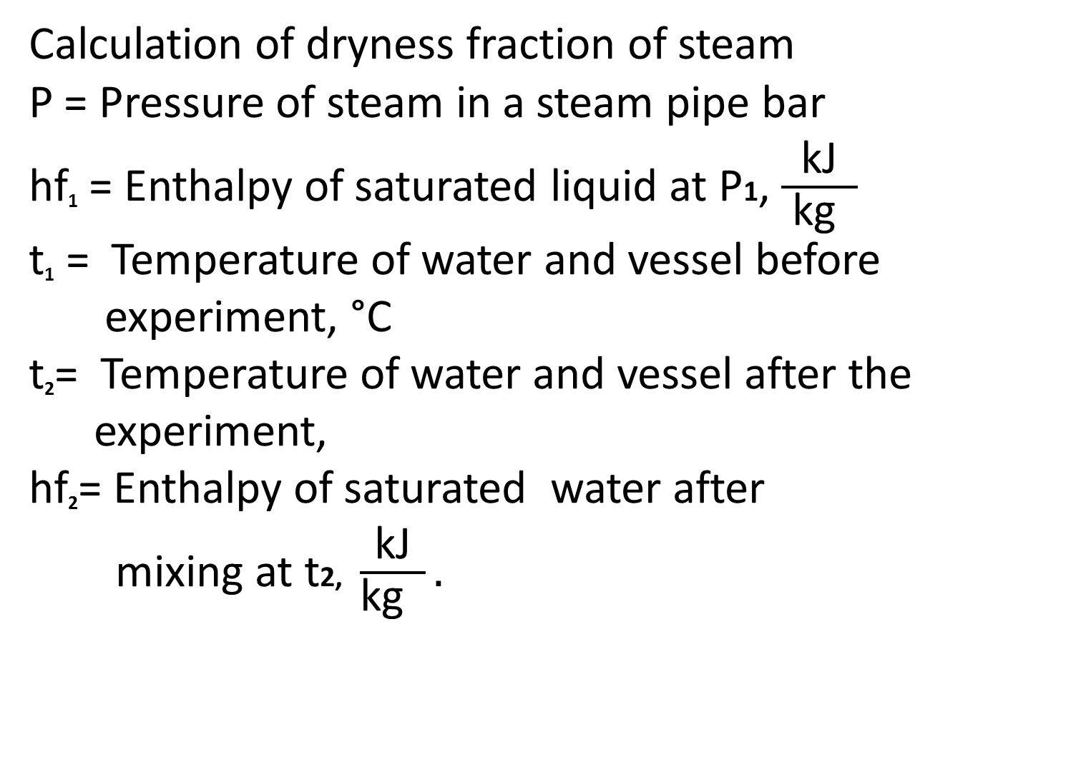
Calculation of dryness fraction of steam
P = Pressure of steam in a steam pipe bar
hf₁ = Enthalpy of saturated liquid at P1, $\frac{\text{kJ}}{ \text{kg} }$
t₁ = Temperature of water and vessel before
experiment, °C
t₂= Temperature of water and vessel after the
experiment,
hf₂= Enthalpy of saturated water after
mixing at t2, $\frac{\text{kJ}}{\text{kg} }.$

Slide 33
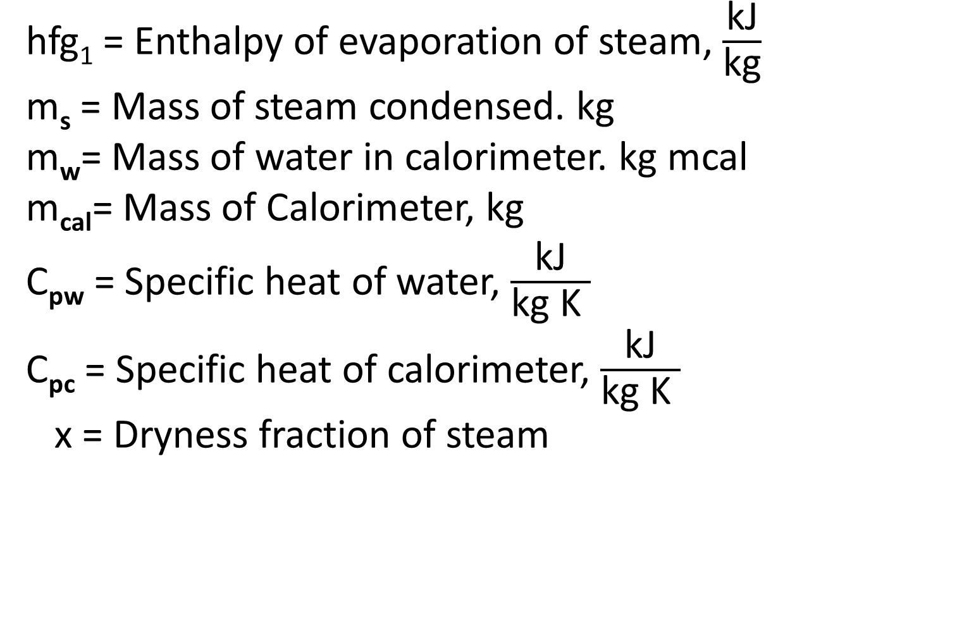
hfg₁ = Enthalpy of evaporation of steam, $\frac{\text{kJ}}{\text{kg}}$
m_{s} = Mass of steam condensed. kg
m_{w}= Mass of water in calorimeter. kg mcal
m_{cal}= Mass of Calorimeter, kg
C_{pw} = Specific heat of water, $\frac{\text{kJ}}{\text{kg} \text{K} }$
C_{pc} = Specific heat of calorimeter, $\frac{\text{kJ}}{\text{kg} \text{K} }$
x = Dryness fraction of steam

Slide 34
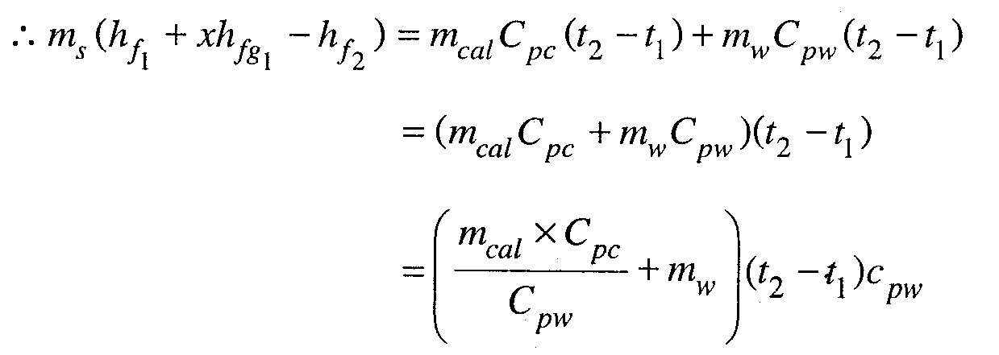
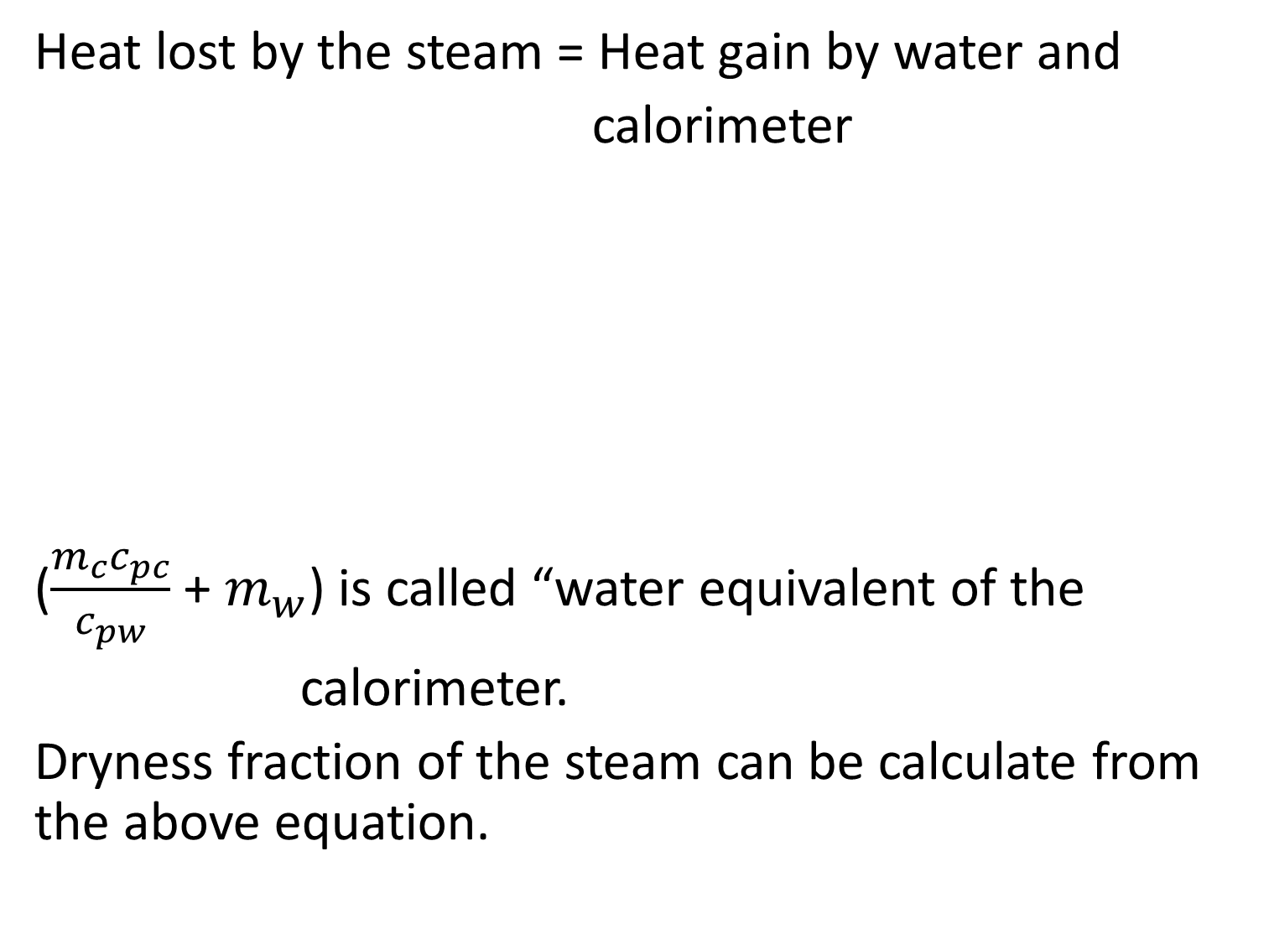
Heat lost by the steam = Heat gain by water and
calorimeter
($\frac{m_{c}c_{pc}}{c_{pw}}$ + $m_{w}$) is called “water equivalent of the
calorimeter.
Dryness fraction of the steam can be calculate from the above equation.

Slide 35
Limitations:
This method is not accurate.
Accuracy decreases as the temperature difference
(T2 – T1) increases because of the losses are more
at higher temperature difference.

Slide 36
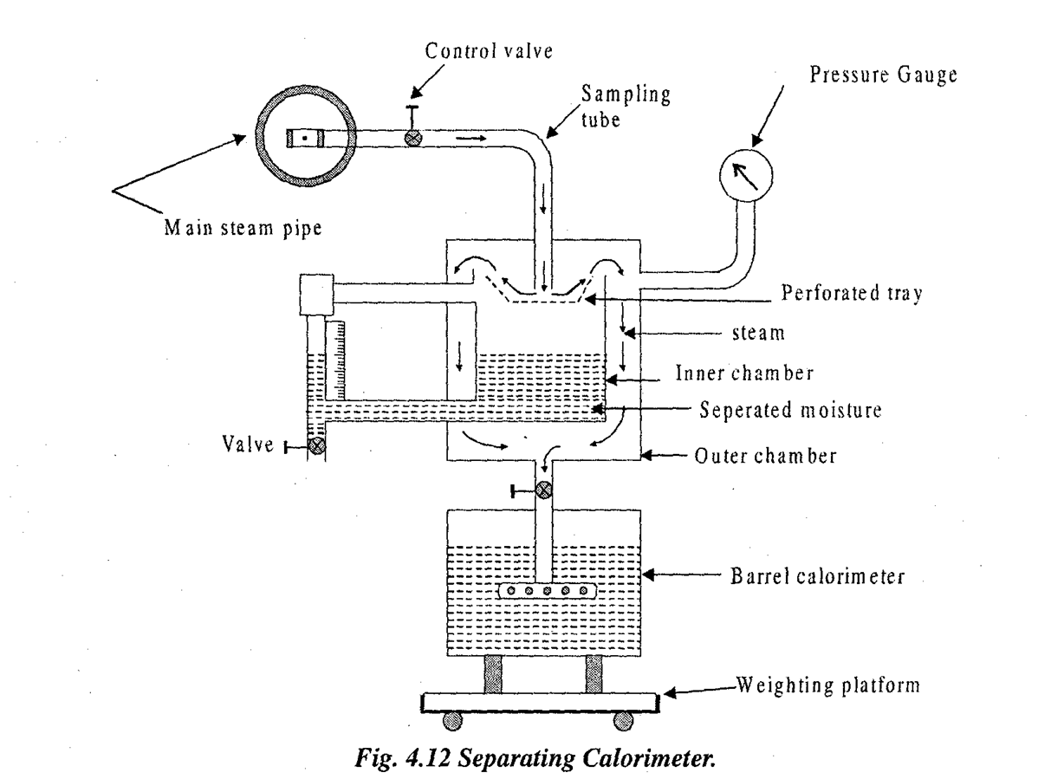
2.Separating Calorimeter:-

Slide 37
Construction :
This calorimeter shown in Figure is used for measuring dryness fraction of very wet steam. This calorimeter works on principle of separating the water particles from a sample of steam and finding their mass fraction in the sample.
Separating calorimeter consists of inner chamber and outer chamber. Perforated tray is provided at the top of inner chamber.

Slide 38
Due to inertia of water droplet, wet steam is separated. Separated droplet is collected in inner chamber while steam is condensed in barrel calorimeter.
Control valve and sampling tube performs same functions as that in barrel calorimeter.

Slide 39
Working :
The steam is supplied to the calorimeter from the main steam pipe through a sampling tube.
Entering steam strikes against the perforated tray in the inner vessel of calorimeter.
By centrifugal force and inertia of droplets, the water particles are separated from steam and they are collected in inner chamber.

Slide 40
Dry steam passes through the annular space between inner and outer vessel.
The steam is condensed in barrel calorimeter.
The quantity of steam condensed can be measured by a weighting machine and quantity of water droplet separated can be measure from scale.
(c) Limitations:
This calorimeter gives only approximate value of dryness fraction.

Slide 41
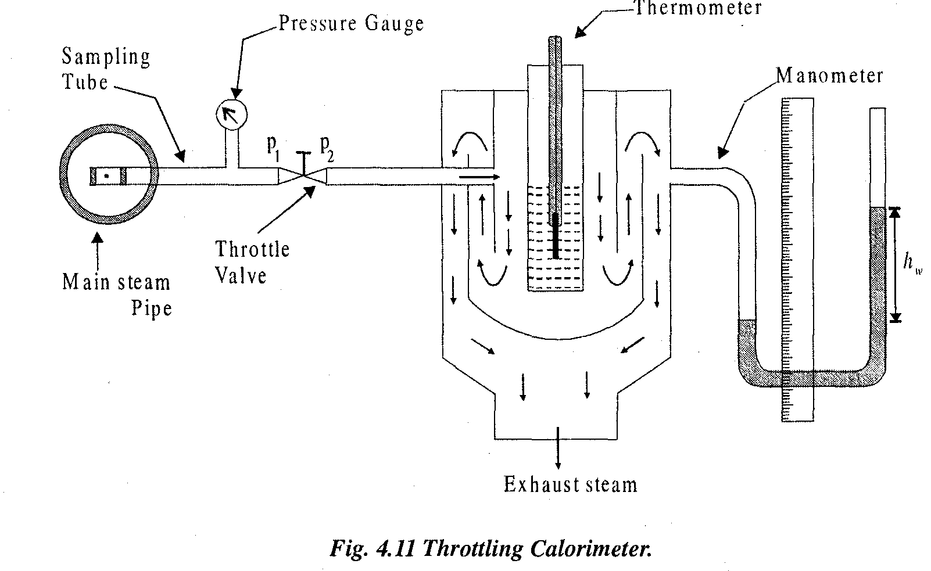
3. Throttling Calorimeter :-

Slide 42
Construction and working : This calorimeter is shown in Figure is used for finding dryness fraction of steam having very low portion of wet particles i.e. high dryness fraction.
In throttling as explained in Art. 4.8 of (7), total enthalpy remains constant before and after throttling process.
As shown in the figure, the sample of steam at pressure p₁ is taken from the main steam pipe to the throttling calorimeter.

Slide 43
The steam is then passed through the throttle valve where it is throttled to very near atmospheric pressure p₂ The pressure of main steam is measured with the help of pressure gauge before throttling, while the U tube manometer reads the pressure of steam after throttling.
The thermometer reads temperature of steam after throttling.
After this throttling, the steam becomes superheated.
The steam path is shown in Figure.

Slide 44
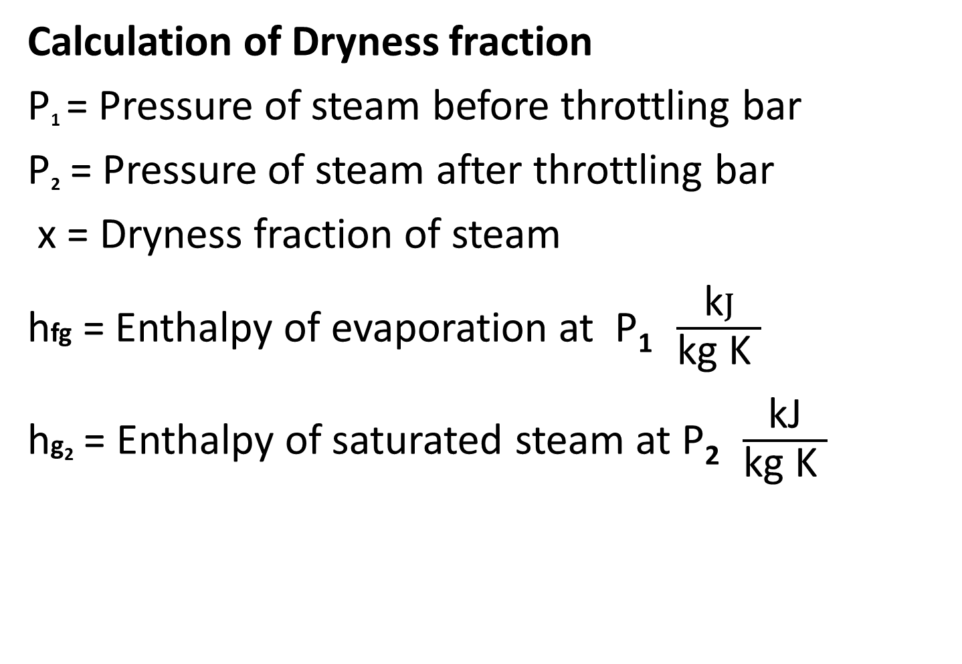
Calculation of Dryness fraction
P₁ = Pressure of steam before throttling bar
P₂ = Pressure of steam after throttling bar
x = Dryness fraction of steam
hfg = Enthalpy of evaporation at P₁ $\frac{\text{k}J}{\text{kg} \text{K} }$
hg₂ = Enthalpy of saturated steam at P₂ $\frac{\text{kJ}}{\text{kg} \text{K} }$

Slide 45
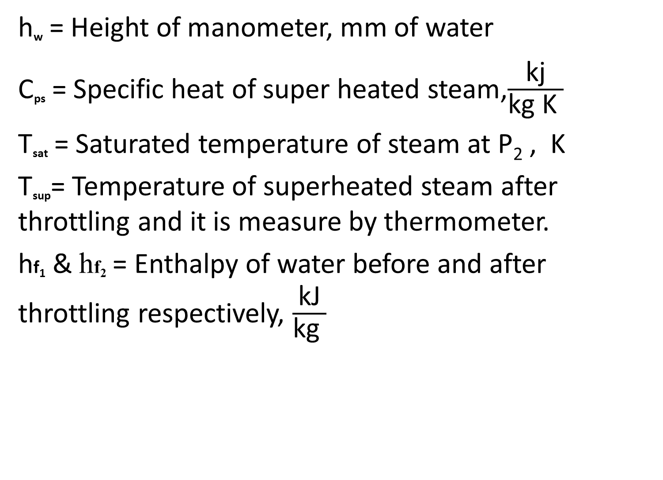
h_{w} = Height of manometer, mm of water
C_{ps} = Specific heat of super heated steam,$\frac{\text{kj}}{\text{kg} \text{K} }$
T_{sat} = Saturated temperature of steam at P₂ , K
T_{sup}= Temperature of superheated steam after throttling and it is measure by thermometer.
hf₁ & hf₂ = Enthalpy of water before and after throttling respectively, $\frac{\text{kJ}}{\text{kg} }$

Slide 46
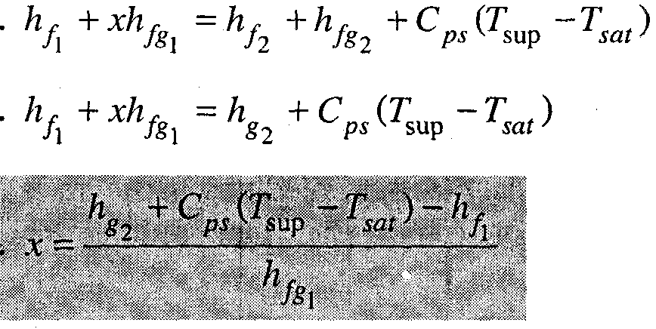
Enthalpy before throttling = Enthalpy after throttling
Enthalpy at P₁ = Enthalpy at P₂

Slide 47
(c) Limitations:
This calorimeter is suitable for measurement
of higher value of dryness fraction i.e. steam
should not be very wet.
(2) After the throttling steam must be at least
dry saturated.

Slide 48
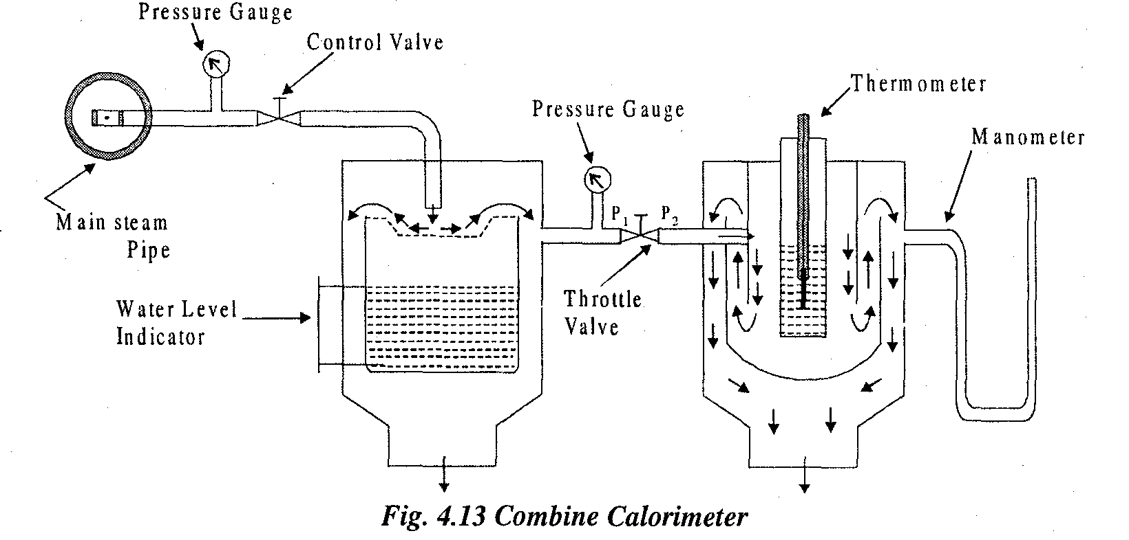
4. Combined Calorimeter:-

Slide 49
Construction & working:
Separating calorimeter gives only approximate result because of complete separation of moisture by mechanical means is not possible.
Throttling calorimeter is not suitable, if steam is very wet (x >0.9).
Also throttling calorimeter fails if the steam is not superheated after throttling.
A combination of separating and throttling calorimeter is therefore found most suitable for accurate measurement of dryness fraction of steam.

Slide 50
Construction and Working :
Figure shows diagram of combined calorimeter.
In this calorimeter, throttling calorimeter and separating calorimeter are placed in series.
In this calorimeter, steam first passes through separating calorimeter.

Slide 51
In separating calorimeter water particles are separated from wet steam and its dryness fraction (x) increases.
The steam coming from separating calorimeter passes through throttling calorimeter where steam becomes superheated after throttling.

Slide 52
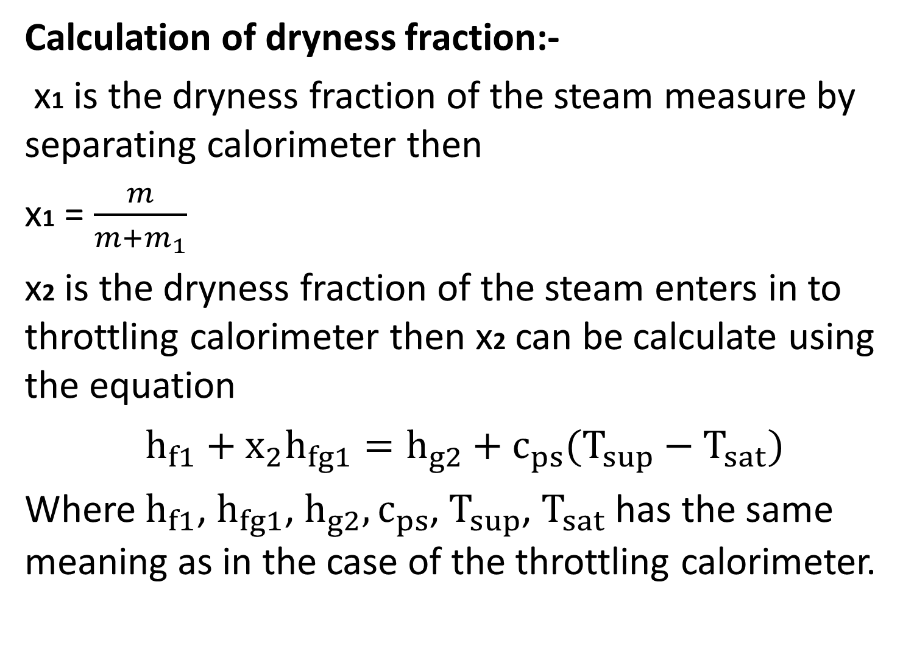
Calculation of dryness fraction:-
x1 is the dryness fraction of the steam measure by separating calorimeter then
x1 = $\frac{m}{m+m_{1}}$
x2 is the dryness fraction of the steam enters in to throttling calorimeter then x2 can be calculate using the equation
$h_{f1}+$ $x_{2}h_{fg1}=h_{g2}+c_{ps}(T_{sup}−T_{sat})$
Where $h_{f1}$, $h_{fg1}$, $h_{g2}, c_{ps}$, $T_{sup}$, $T_{sat}$ has the same meaning as in the case of the throttling calorimeter.

Slide 53
x is the initial dryness fraction of the steam then the original water droplet in the sample is
(1-x)(m + m1).
From this
(1-x1)(m + m1) kg is remove by the separating calorimeter.
(1-x2)(m) kg is pass through throttling calorimeter.

Slide 54
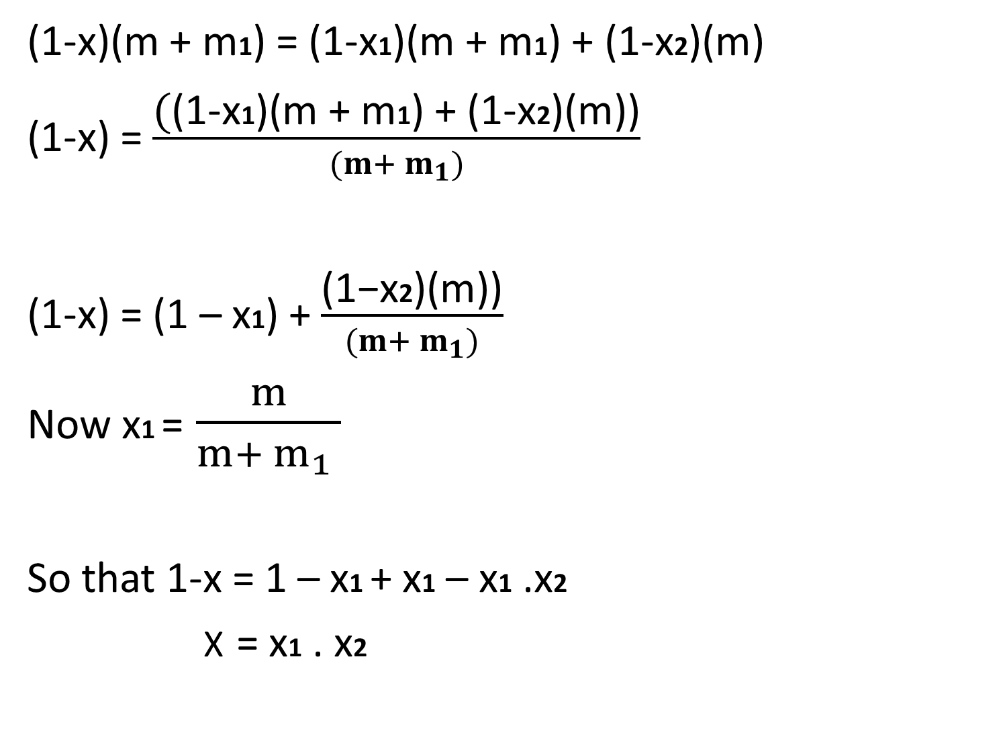
(1-x)(m + m1) = (1-x1)(m + m1) + (1-x2)(m)
(1-x) = $\frac{\text{(}\text{(1−}\text{x}\text{1}\text{)(}\text{m}\text{ + }\text{m}\text{1}\text{) + (1−}\text{x}\text{2}\text{)(}\text{m}\text{))}}{(m+ m_{1})}$
(1-x) = (1 – x1) +$\frac{\text{(1−}\text{x}\text{2}\text{)(}\text{m}\text{))}}{(m+ m_{1})}$
Now x1 = $\frac{m}{m+ m_{1} }$
So that 1-x = 1 – x1 + x1 – x1 .x2
X = x1 . x2

Slide 55
Numericals of Properties of Steam
Calculate the external workdone during the evaporation, internal energy of the steam and internal heat of evaporation for the steam having 10 bar of pressure and the dryness fraction is 0.8.
Solution:
External workdone = ?
Internal energy of the steam = ?
Internal heat of evaporation = ?
P =10 bar , x = 0.8

Slide 56
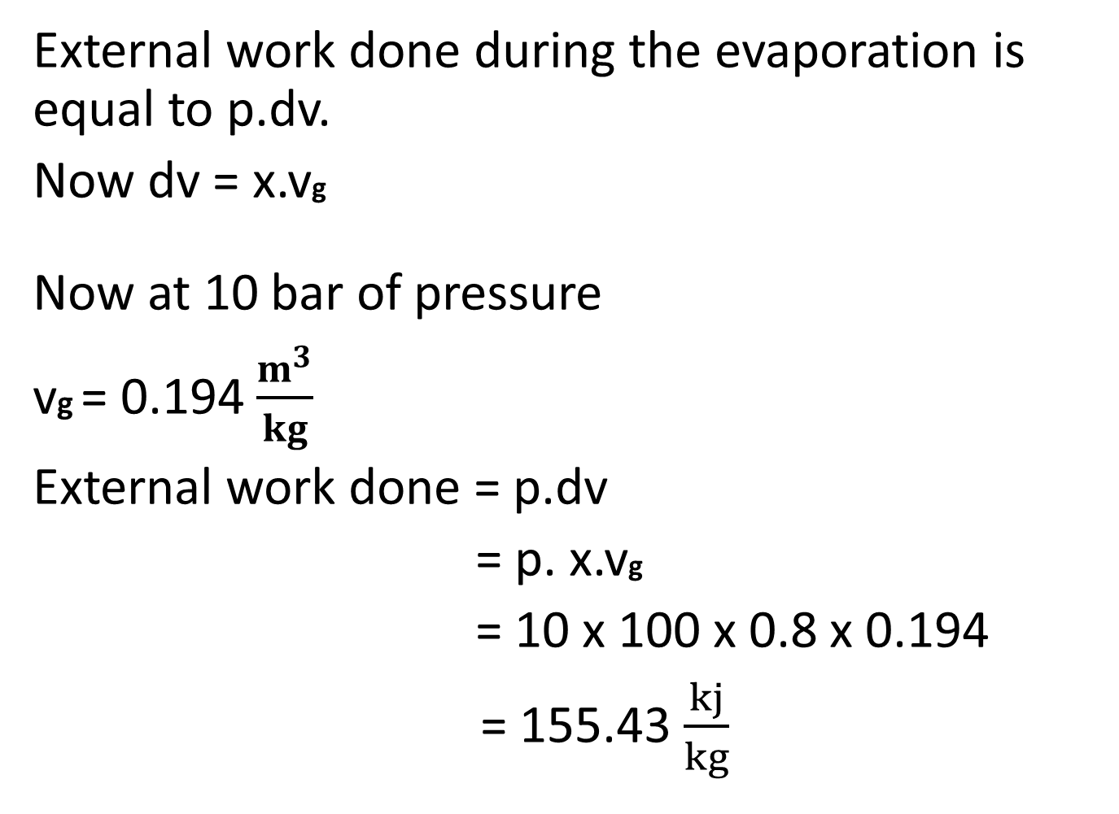
External work done during the evaporation is equal to p.dv.
Now dv = x.vg
Now at 10 bar of pressure
vg = 0.194 $\frac{m^{3}}{kg}$
External work done = p.dv
= p. x.vg
= 10 x 100 x 0.8 x 0.194
= 155.43 $\frac{kj}{kg}$

Slide 57
Internal energy of the steam can be calculate by
u = h –pv
So for find out the internal energy we have to find out the enthalpy of the steam at 10 bar pressure with a dryness fraction of 0.8 needs to be calculated. For the wet steam
h = hf + xhfg

Slide 58

At 10 bar of pressure hf = 762.80 $\frac{kj}{kg}$
hfg = 2015.3 $\frac{kj}{kg}$
h = hf + xhfg
= 762.80 + 0.8x2015.3
= 2375.04 $\frac{kj}{kg}$

Slide 59
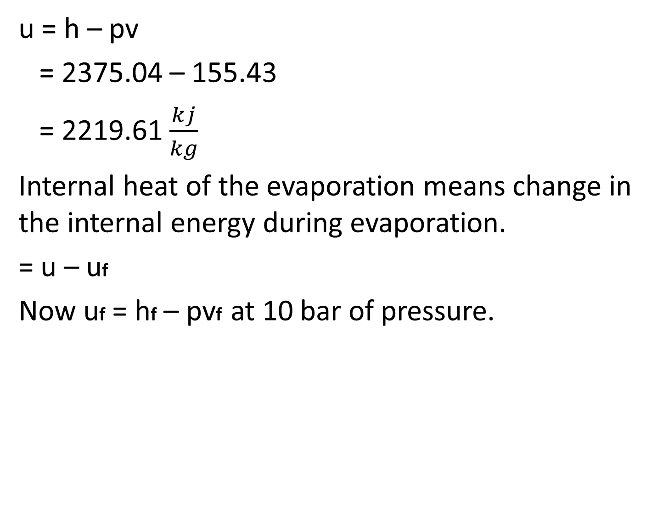
u = h – pv
= 2375.04 – 155.43
= 2219.61 $\frac{kj}{kg}$
Internal heat of the evaporation means change in the internal energy during evaporation.
= u – uf
Now uf = hf – pvf at 10 bar of pressure.

Slide 60
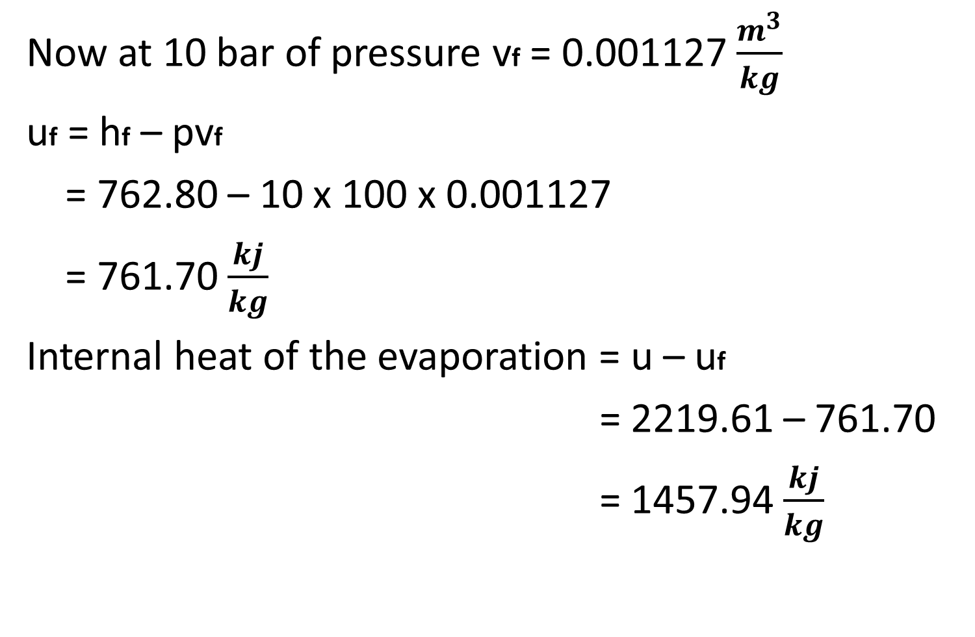
Now at 10 bar of pressure vf = 0.001127 $\frac{m^{3}}{kg}$
uf = hf – pvf
= 762.80 – 10 x 100 x 0.001127
= 761.70 $\frac{kj}{kg}$
Internal heat of the evaporation = u – uf
= 2219.61 – 761.70
= 1457.94 $\frac{kj}{kg}$

Slide 61
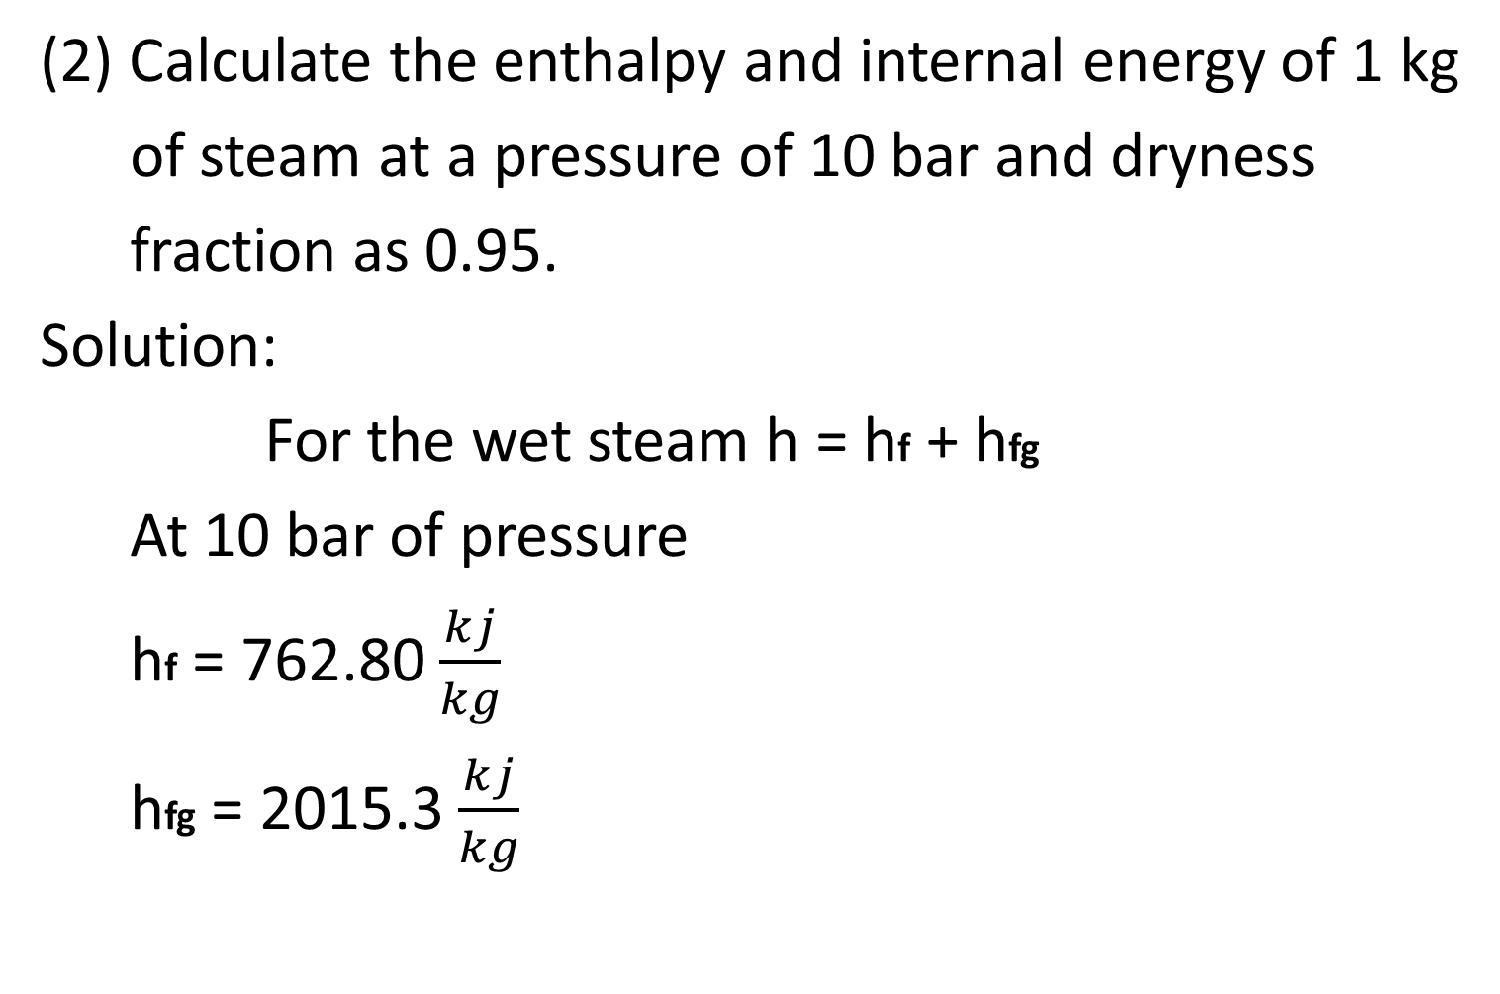
(2) Calculate the enthalpy and internal energy of 1 kg
of steam at a pressure of 10 bar and dryness
fraction as 0.95.
Solution:
For the wet steam h = hf + hfg
At 10 bar of pressure
hf = 762.80 $\frac{kj}{kg}$
hfg = 2015.3 $\frac{kj}{kg}$

Slide 62

h = hf + hfg
h = 762.80 + 0.95 x 2015.30
= 2677.30 $\frac{kj}{kg}$

Slide 63
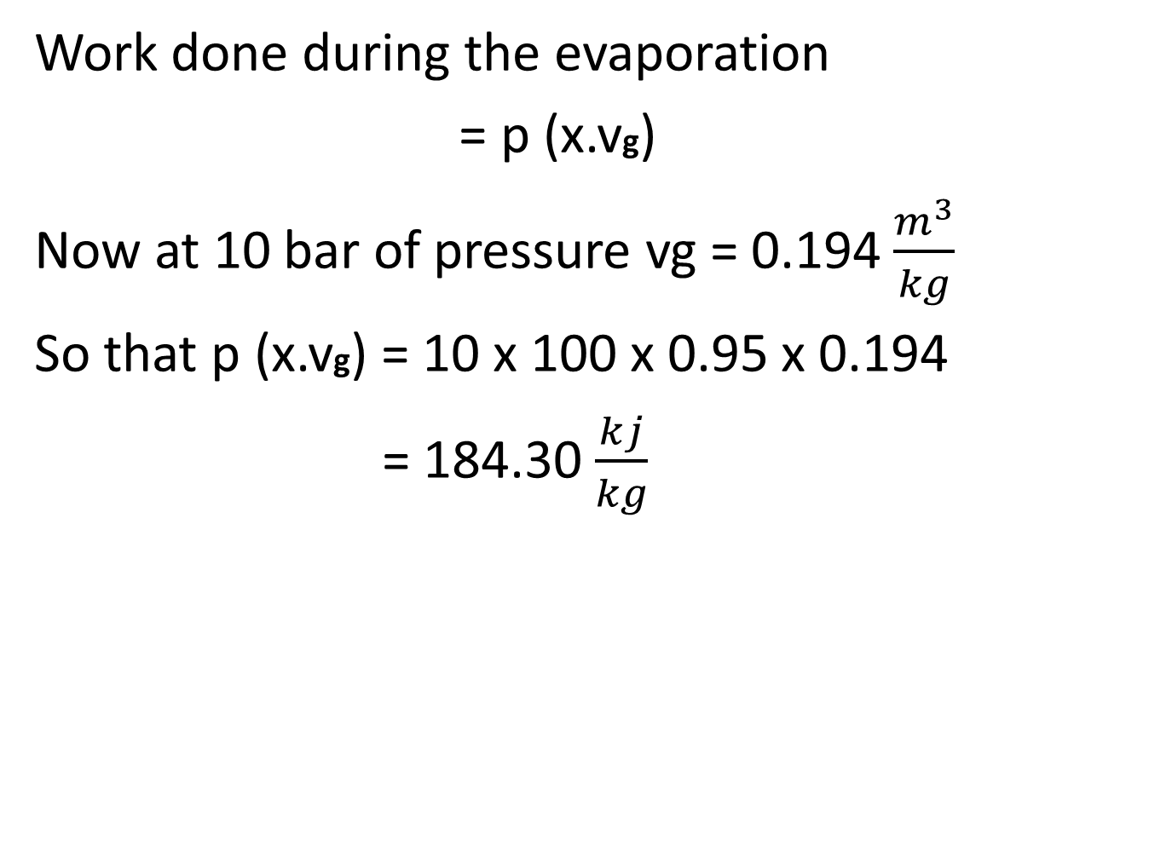
Work done during the evaporation
= p (x.vg)
Now at 10 bar of pressure vg = 0.194 $\frac{m^{3}}{kg}$
So that p (x.vg) = 10 x 100 x 0.95 x 0.194
= 184.30 $\frac{kj}{kg}$

Slide 64

Internal Energy u = h – pv
= 2677.30 – 184.30
= 2493 $\frac{kj}{kg}$

Slide 65
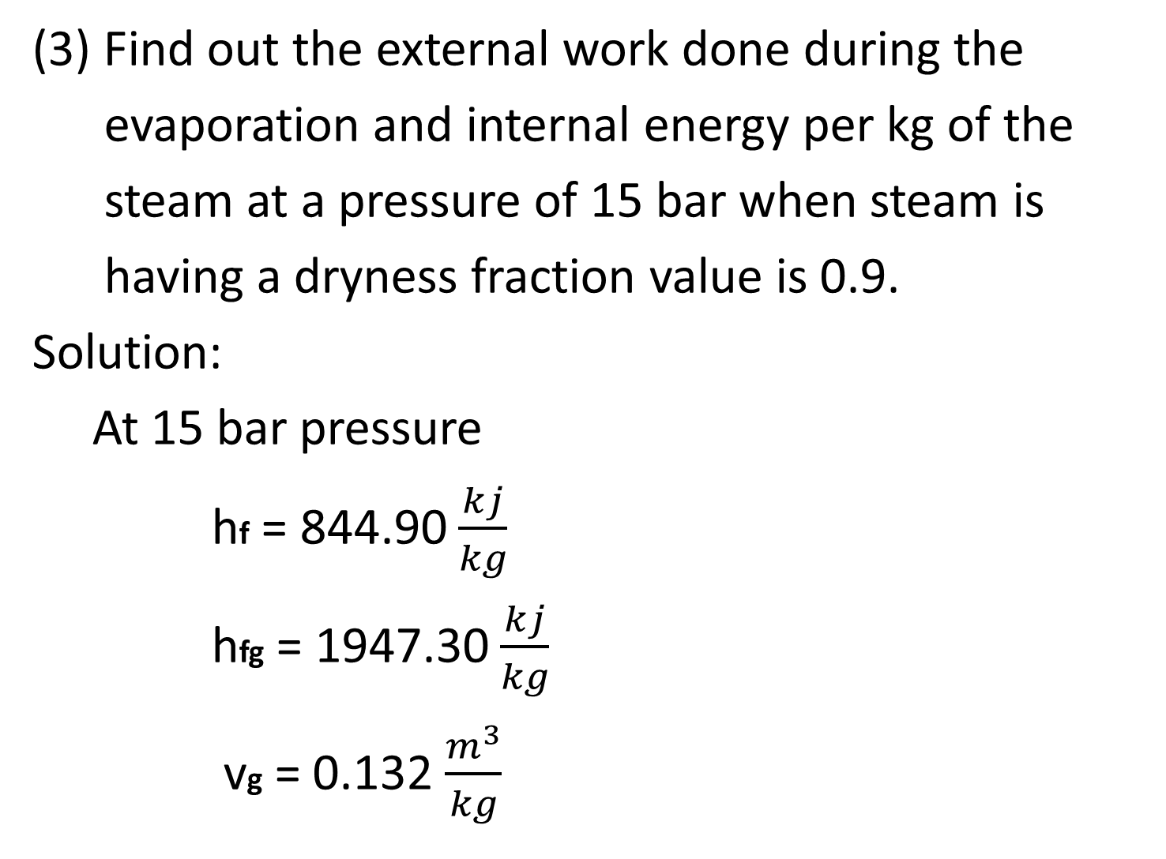
(3) Find out the external work done during the
evaporation and internal energy per kg of the
steam at a pressure of 15 bar when steam is
having a dryness fraction value is 0.9.
Solution:
At 15 bar pressure
hf = 844.90 $\frac{kj}{kg}$
hfg = 1947.30 $\frac{kj}{kg}$
vg = 0.132 $\frac{m^{3}}{kg}$

Slide 66
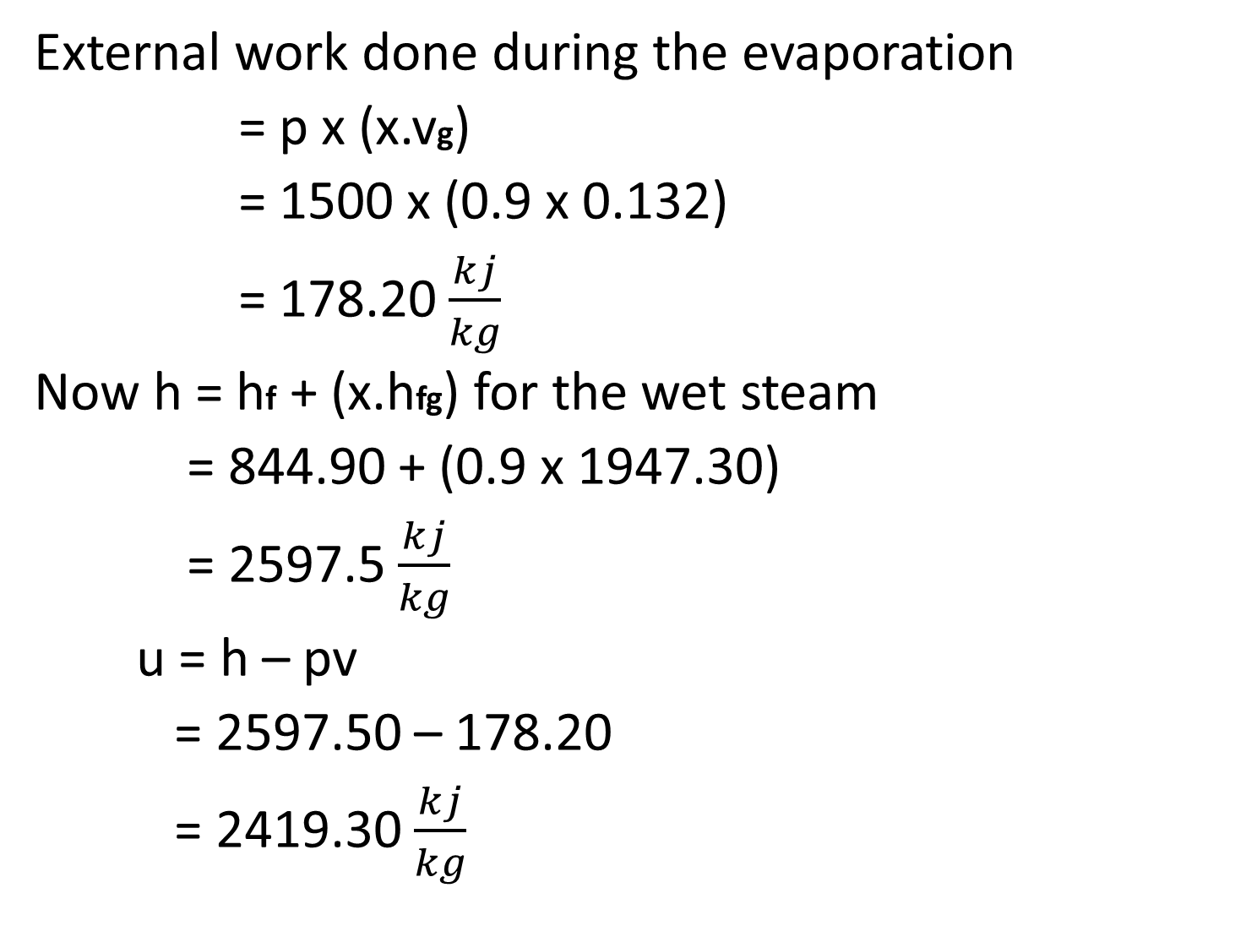
External work done during the evaporation
= p x (x.vg)
= 1500 x (0.9 x 0.132)
= 178.20 $\frac{kj}{kg}$
Now h = hf + (x.hfg) for the wet steam
= 844.90 + (0.9 x 1947.30)
= 2597.5 $\frac{kj}{kg}$
u = h – pv
= 2597.50 – 178.20
= 2419.30 $\frac{kj}{kg}$

Slide 67
(4) 1.5 kg of the steam at a pressure of 10 bar and
temperature of 250 °C is expanding until the
pressure becomes 2.8 bar. The dryness fraction of
the steam is then 0.9. Calculate change in the
internal energy.
Solution:
u1 = specific internal energy at 10 bar 250 °C
u2 = specific internal energy at 2.8 bar
Dryness fraction x = 0.9

Slide 68
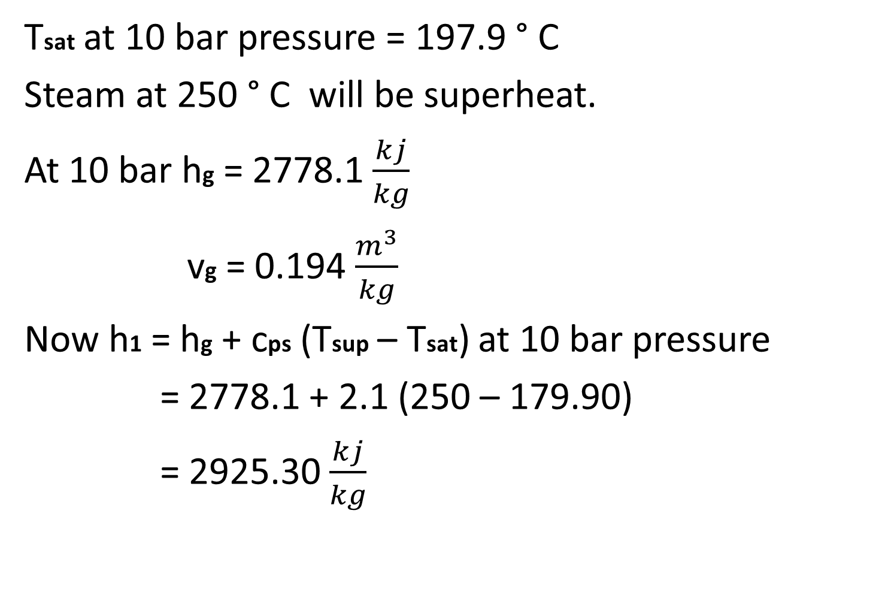
Tsat at 10 bar pressure = 197.9 ° C
Steam at 250 ° C will be superheat.
At 10 bar hg = 2778.1 $\frac{kj}{kg}$
vg = 0.194 $\frac{m^{3}}{kg}$
Now h1 = hg + cps (Tsup – Tsat) at 10 bar pressure
= 2778.1 + 2.1 (250 – 179.90)
= 2925.30 $\frac{kj}{kg}$

Slide 69
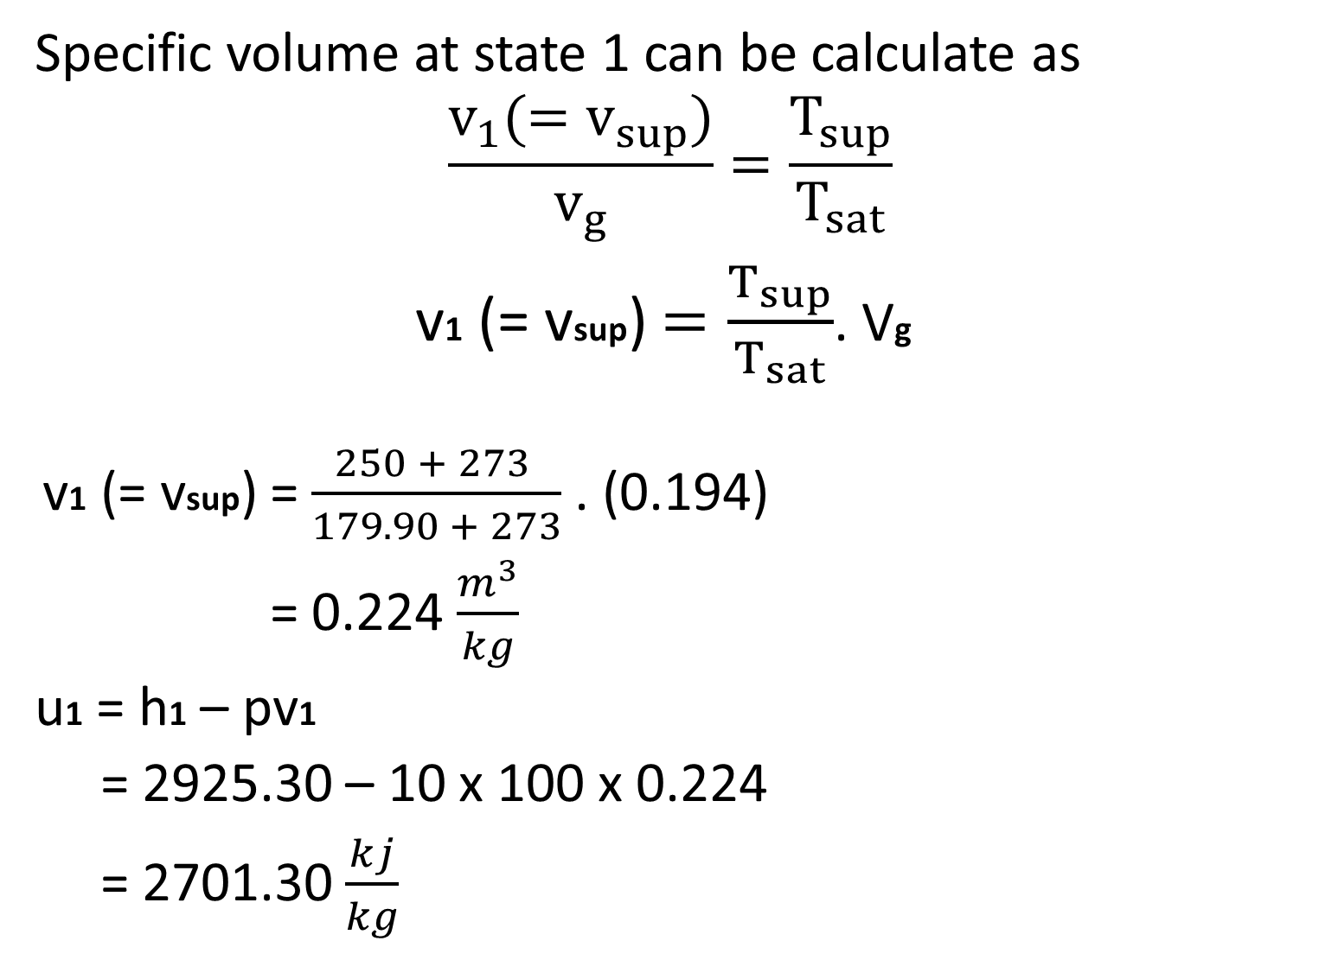
Specific volume at state 1 can be calculate as
$$\frac{v_{1}{(=v}_{sup})}{v_{g}}=\frac{T_{sup}}{T_{sat}}$$
v1 (= vsup) $=\frac{T_{sup}}{T_{sat}}$. Vg
v1 (= vsup) = $\frac{250 + 273 }{179.90 + 273}$ . (0.194)
= 0.224 $\frac{m^{3}}{kg}$
u1 = h1 – pv1
= 2925.30 – 10 x 100 x 0.224
= 2701.30 $\frac{kj}{kg}$

Slide 70
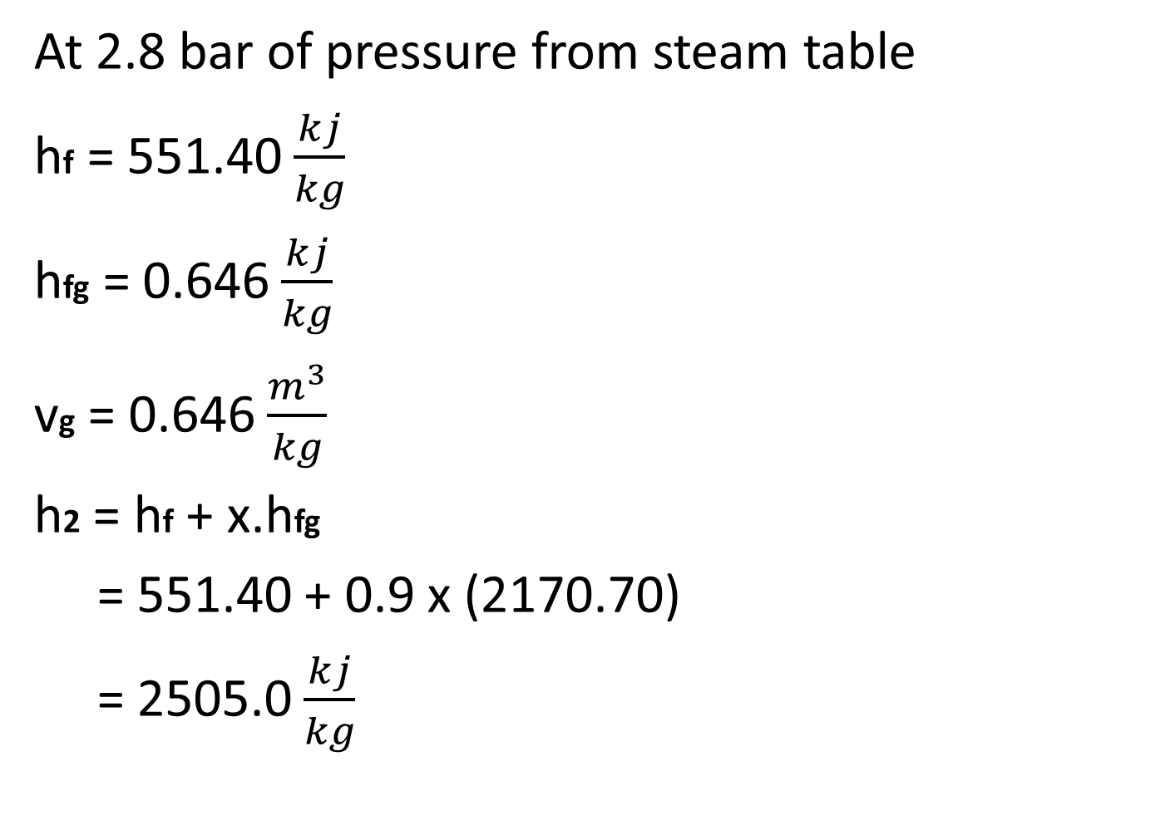
At 2.8 bar of pressure from steam table
hf = 551.40 $\frac{kj}{kg}$
hfg = 0.646 $\frac{kj}{kg}$
vg = 0.646 $\frac{m^{3}}{kg}$
h2 = hf + x.hfg
= 551.40 + 0.9 x (2170.70)
= 2505.0 $\frac{kj}{kg}$

Slide 71
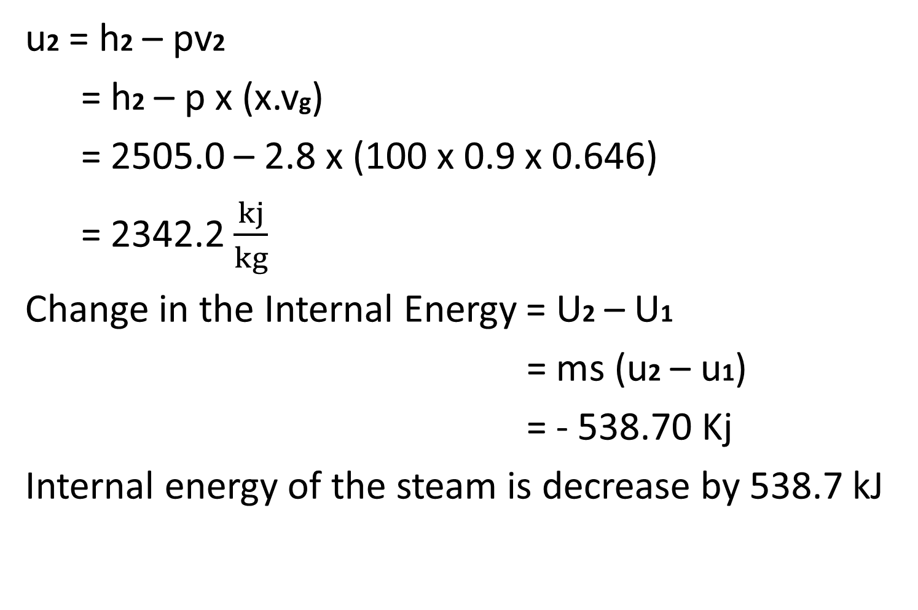
u2 = h2 – pv2
= h2 – p x (x.vg)
= 2505.0 – 2.8 x (100 x 0.9 x 0.646)
= 2342.2 $\frac{kj}{kg}$
Change in the Internal Energy = U2 – U1
= ms (u2 – u1)
= - 538.70 Kj
Internal energy of the steam is decrease by 538.7 kJ

Slide 72
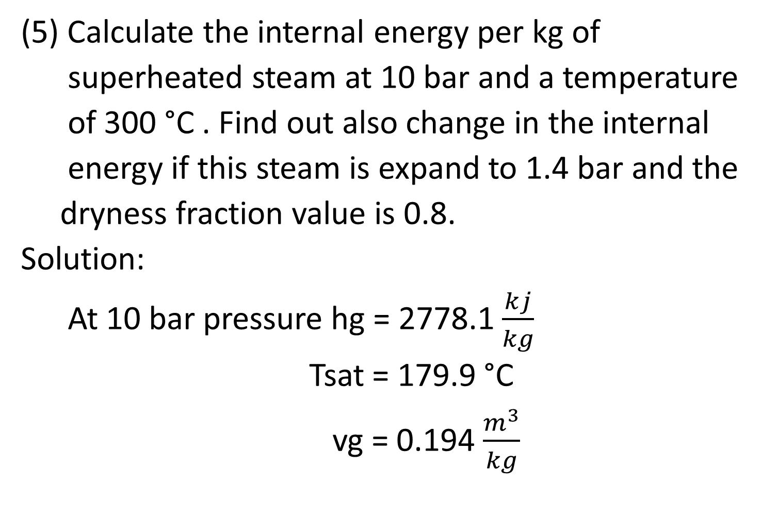
(5) Calculate the internal energy per kg of
superheated steam at 10 bar and a temperature
of 300 °C . Find out also change in the internal
energy if this steam is expand to 1.4 bar and the
dryness fraction value is 0.8.
Solution:
At 10 bar pressure hg = 2778.1 $\frac{kj}{kg}$
Tsat = 179.9 °C
vg = 0.194 $\frac{m^{3}}{kg}$

Slide 73
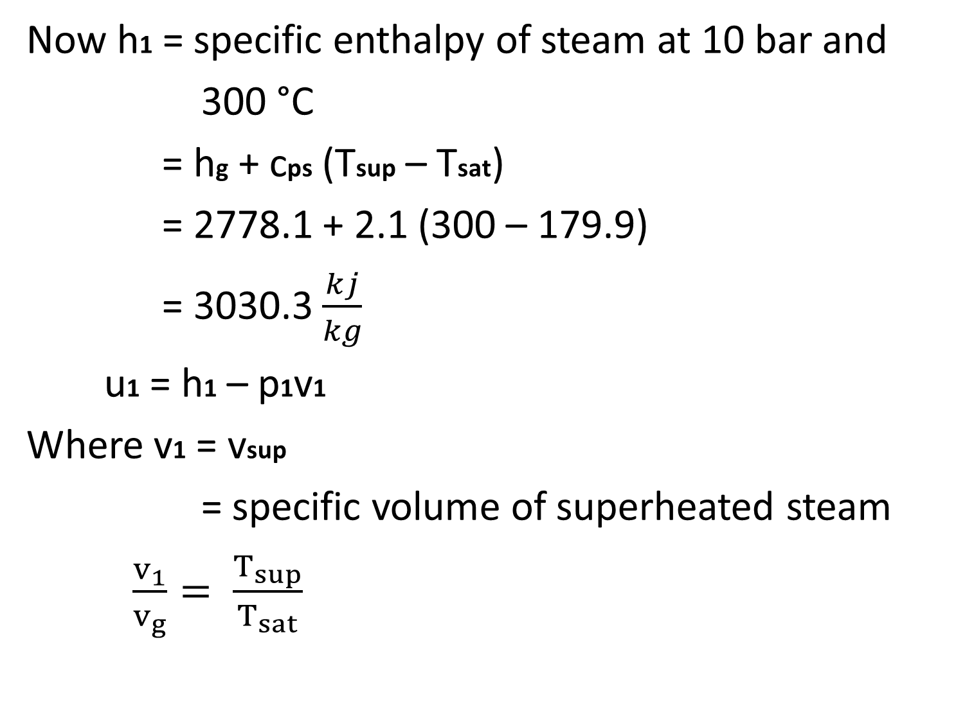
Now h1 = specific enthalpy of steam at 10 bar and
300 °C
= hg + cps (Tsup – Tsat)
= 2778.1 + 2.1 (300 – 179.9)
= 3030.3 $\frac{kj}{kg}$
u1 = h1 – p1v1
Where v1 = vsup
= specific volume of superheated steam
$\frac{v_{1}}{v_{g}}= \frac{T_{sup}}{T_{sat}}$

Slide 74

v1 = vg . $\frac{T_{sup}}{T_{sat}}$
= 0.194. $\frac{300 + 273}{179.9 +273}$
= 0.245 $\frac{m^{3}}{kg}$
U1 = 3030.3 – 10 x 100 x 0.245
= 2785.3 $\frac{kj}{kg}$

Slide 75
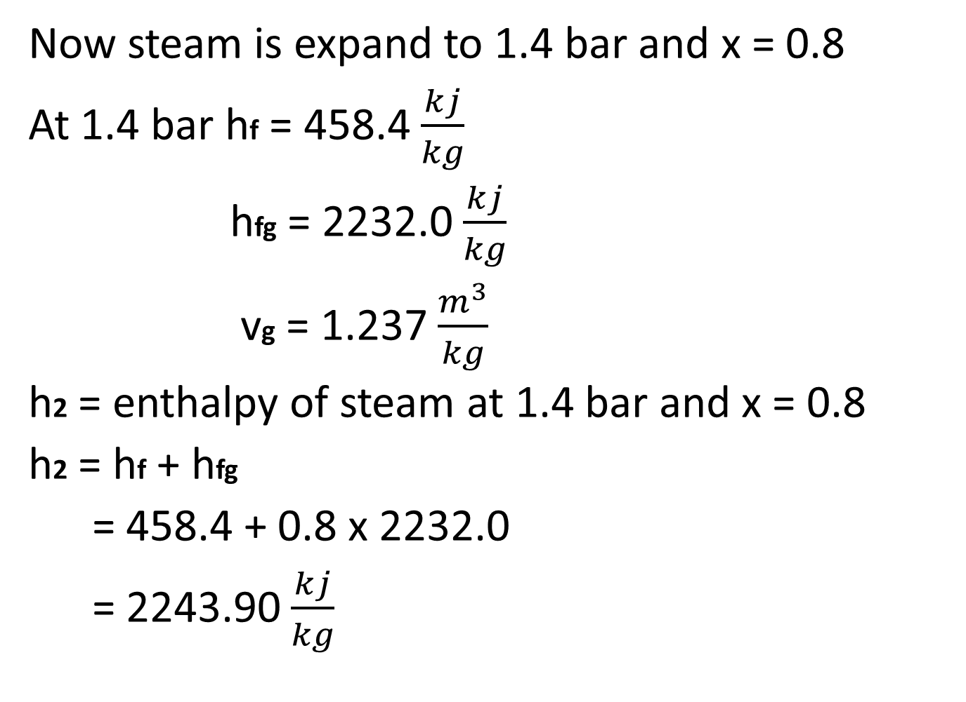
Now steam is expand to 1.4 bar and x = 0.8
At 1.4 bar hf = 458.4 $\frac{kj}{kg}$
hfg = 2232.0 $\frac{kj}{kg}$
vg = 1.237 $\frac{m^{3}}{kg}$
h2 = enthalpy of steam at 1.4 bar and x = 0.8
h2 = hf + hfg
= 458.4 + 0.8 x 2232.0
= 2243.90 $\frac{kj}{kg}$

Slide 76
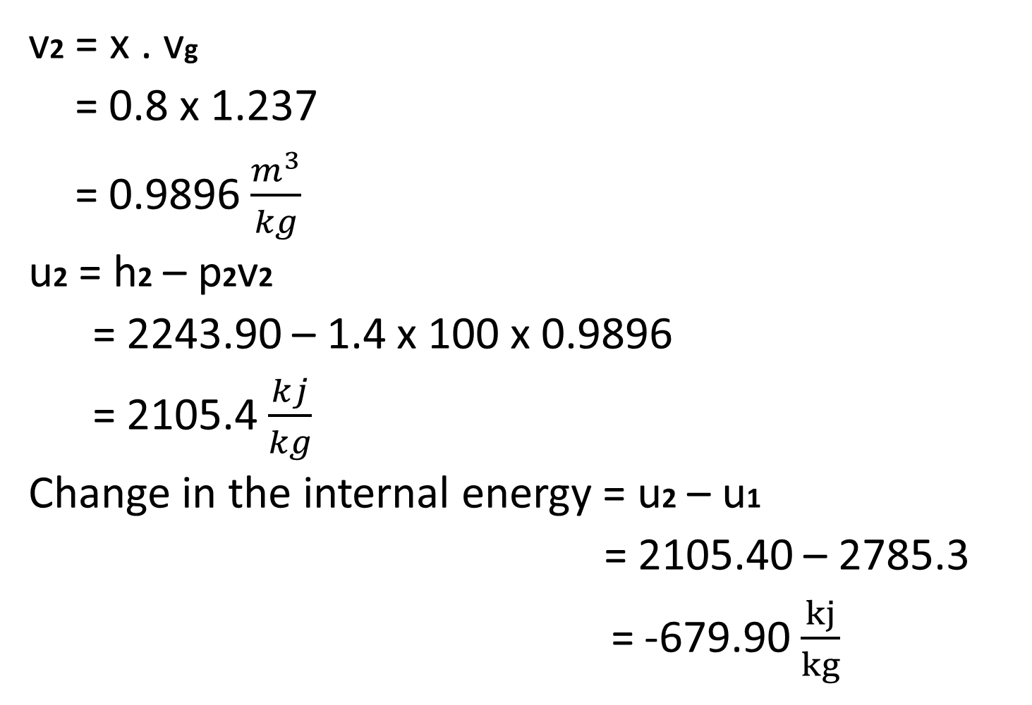
v2 = x . vg
= 0.8 x 1.237
= 0.9896 $\frac{m^{3}}{kg}$
u2 = h2 – p2v2
= 2243.90 – 1.4 x 100 x 0.9896
= 2105.4 $\frac{kj}{kg}$
Change in the internal energy = u2 – u1
= 2105.40 – 2785.3
= -679.90 $\frac{kj}{kg}$

Slide 77
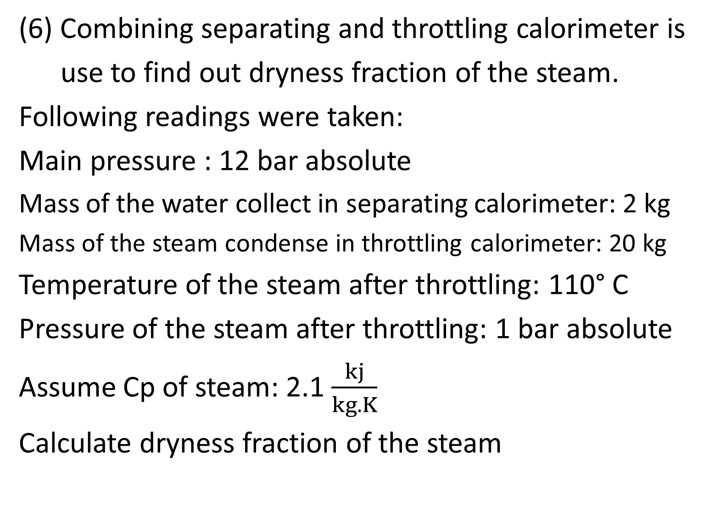
(6) Combining separating and throttling calorimeter is
use to find out dryness fraction of the steam.
Following readings were taken:
Main pressure : 12 bar absolute
Mass of the water collect in separating calorimeter: 2 kg
Mass of the steam condense in throttling calorimeter: 20 kg
Temperature of the steam after throttling: 110° C
Pressure of the steam after throttling: 1 bar absolute
Assume Cp of steam: 2.1 $\frac{kj}{kg.K}$
Calculate dryness fraction of the steam

Slide 78
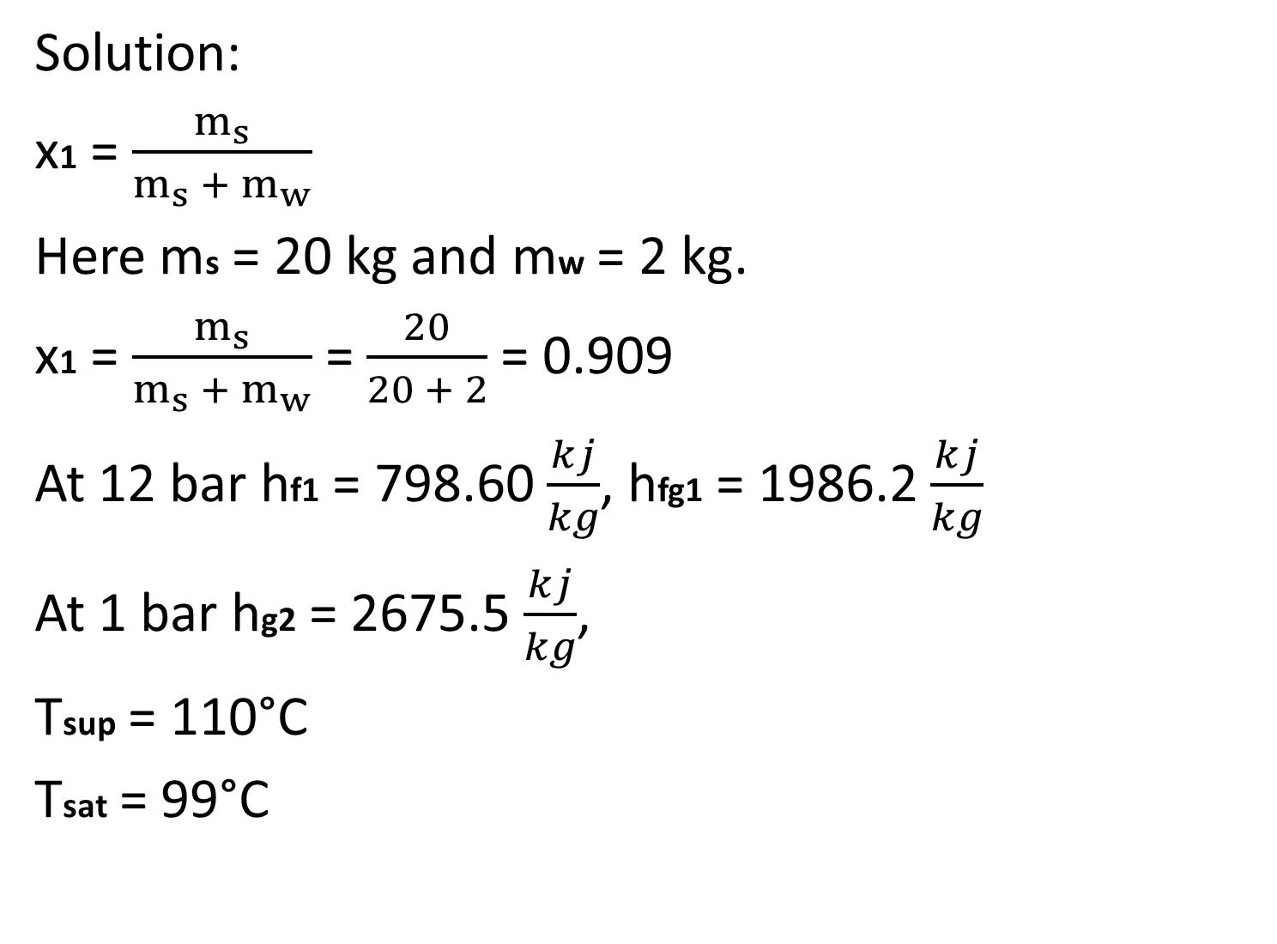
Solution:
x1 = $\frac{m_{s}}{m_{s} + m_{w}}$
Here ms = 20 kg and mw = 2 kg.
x1 = $\frac{m_{s}}{m_{s} + m_{w}}$ = $\frac{20}{20 + 2}$ = 0.909
At 12 bar hf1 = 798.60 $\frac{kj}{kg}$, hfg1 = 1986.2 $\frac{kj}{kg}$
At 1 bar hg2 = 2675.5 $\frac{kj}{kg}$,
Tsup = 110°C
Tsat = 99°C

Slide 79
For the throttling process
h1 = h2
Where h1 and h2 are the enthalpy of the steam before and after the throttling process
hf1 + x2.hfg1 = hg2 +cps (Tsup – Tsat)
798.6 + x2. 1986.2 = 2675.5 + 2.1 x (110 – 99)
X2 = 0.9566
Dryness fraction of the steam at inlet to the calorimeter
x = x1.x2
= 0.909 x 0.9566
= 0.8595

Slide 80
(7) The following information is available from test of
a combined separating and throttling calorimeter.
Pressure of the steam in a steam main = 9.0 bar
Pressure after the throttling = 1.0 bar
Temperature after throttling = 115°C
Mass of the steam condense after throttling = 1.8kg
Mass of the water collect in the separator = 0.2 kg
Calculate the dryness fraction of the steam in the main.

Slide 81
Given:
P1 = 9 bar
m = 1.8 kg
P2 = 1 bar
m1 = 0.2 kg
T2 = 115°C
x = ?

Slide 82
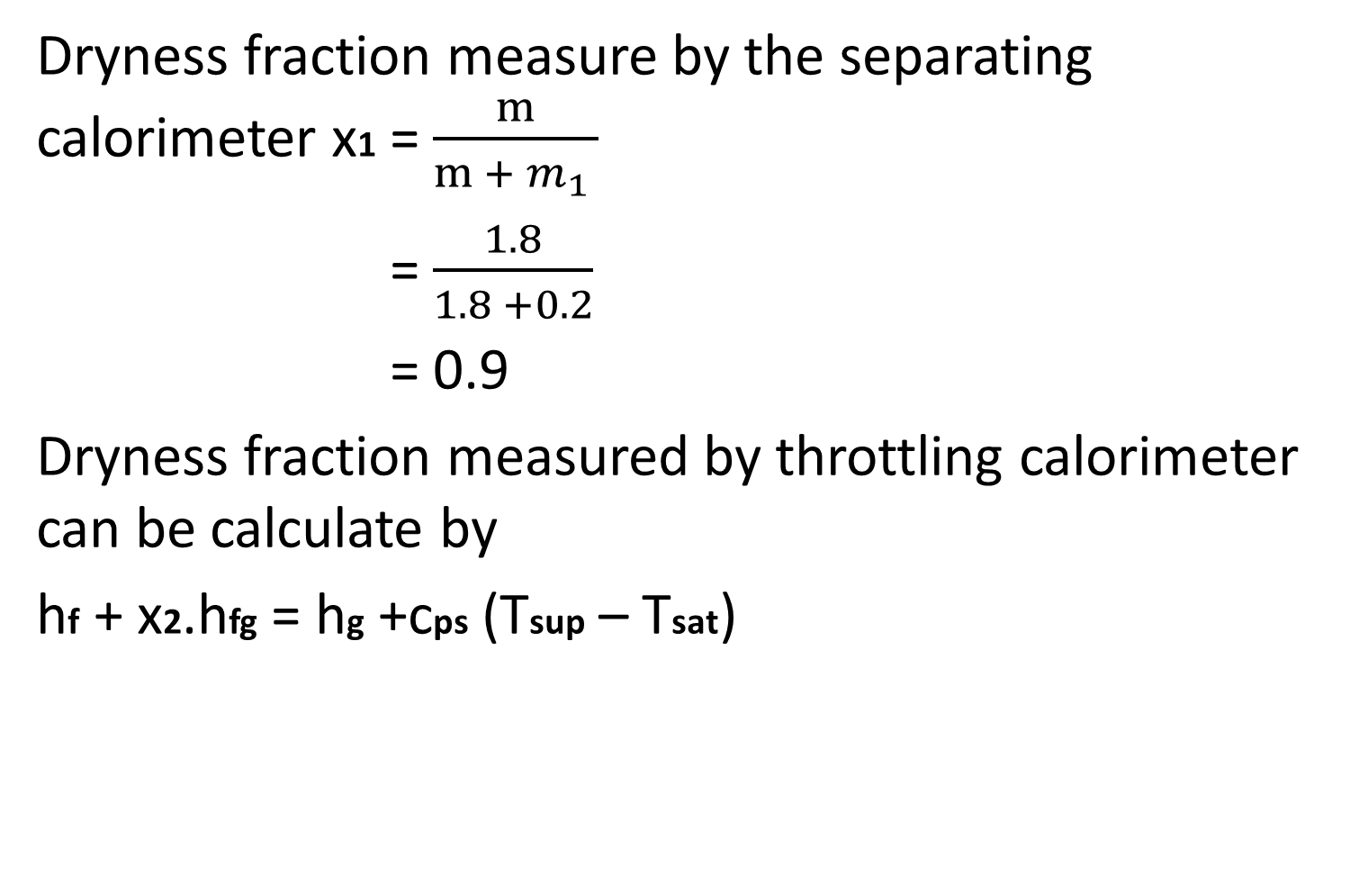
Dryness fraction measure by the separating calorimeter x1 = $\frac{m}{m + m_{1} }$
= $\frac{1.8}{1.8 +0.2}$
= 0.9
Dryness fraction measured by throttling calorimeter can be calculate by
hf + x2.hfg = hg +cps (Tsup – Tsat)

Slide 83
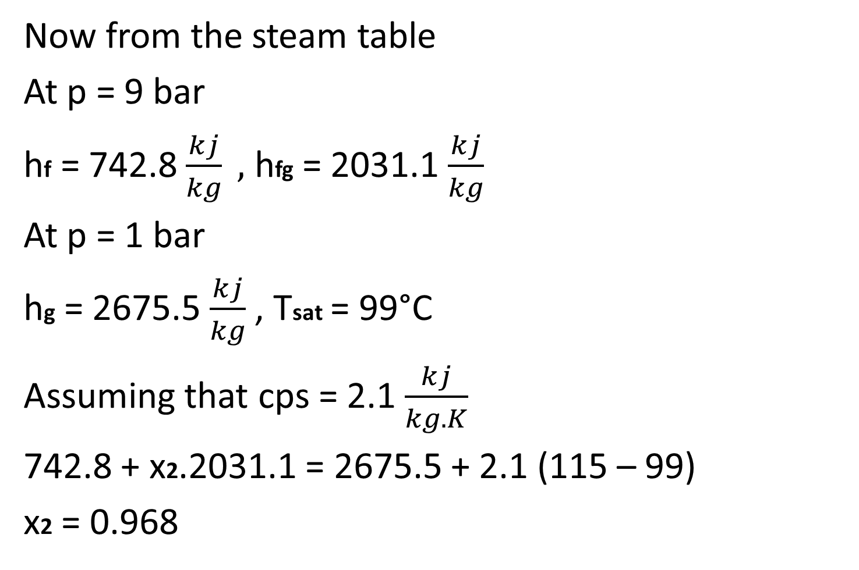
Now from the steam table
At p = 9 bar
hf = 742.8 $\frac{kj}{kg} ,$ hfg = 2031.1 $\frac{kj}{kg}$
At p = 1 bar
hg = 2675.5 $\frac{kj}{kg}$ , Tsat = 99°C
Assuming that cps = 2.1 $\frac{kj}{kg.K}$
742.8 + x2.2031.1 = 2675.5 + 2.1 (115 – 99)
x2 = 0.968

Slide 84
Dryness fraction of the steam in the main
x = x1.x2
= 0.9 x 0.968
= 0.8712

Slide 85
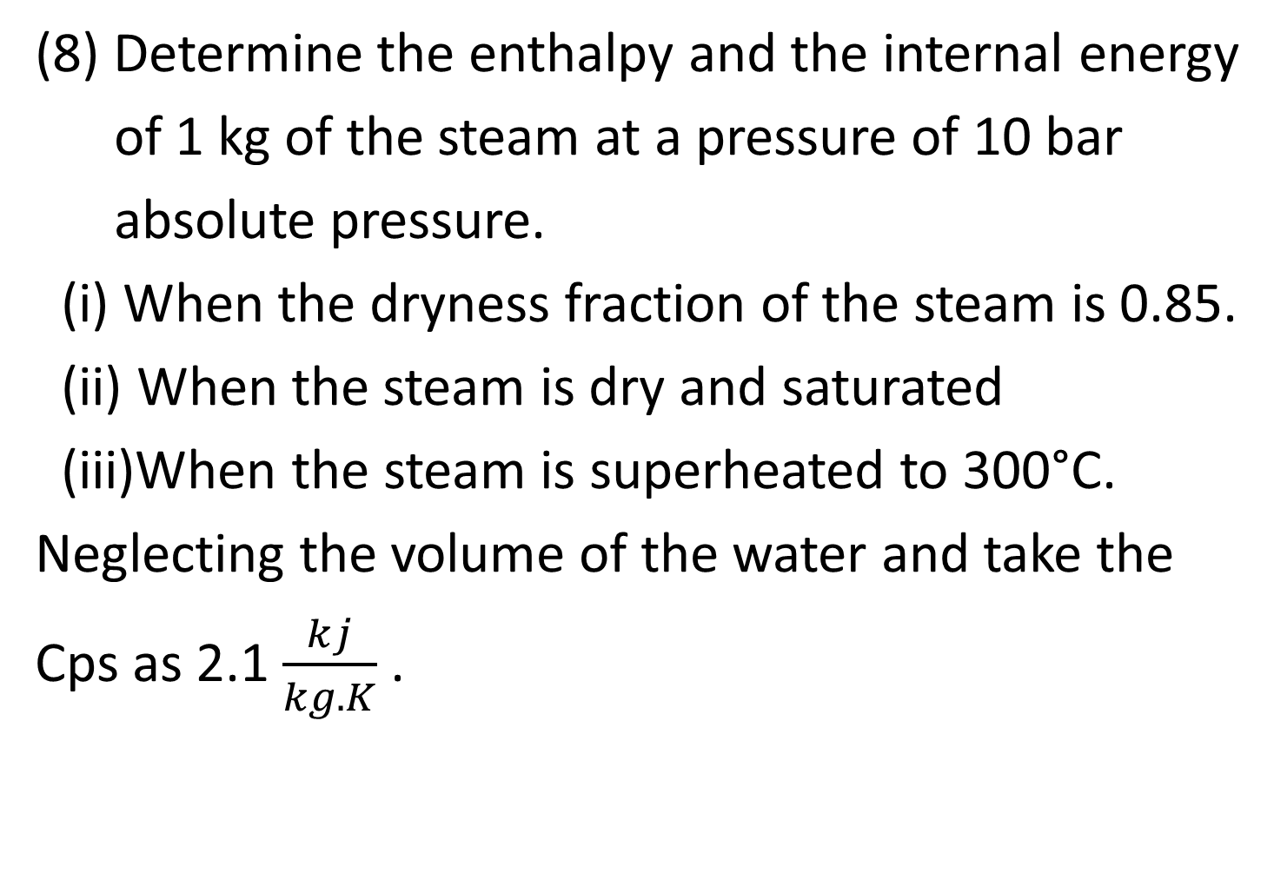
(8) Determine the enthalpy and the internal energy
of 1 kg of the steam at a pressure of 10 bar
absolute pressure.
(i) When the dryness fraction of the steam is 0.85.
(ii) When the steam is dry and saturated
(iii)When the steam is superheated to 300°C.
Neglecting the volume of the water and take the
Cps as 2.1 $\frac{kj}{kg.K}$ .

Slide 86
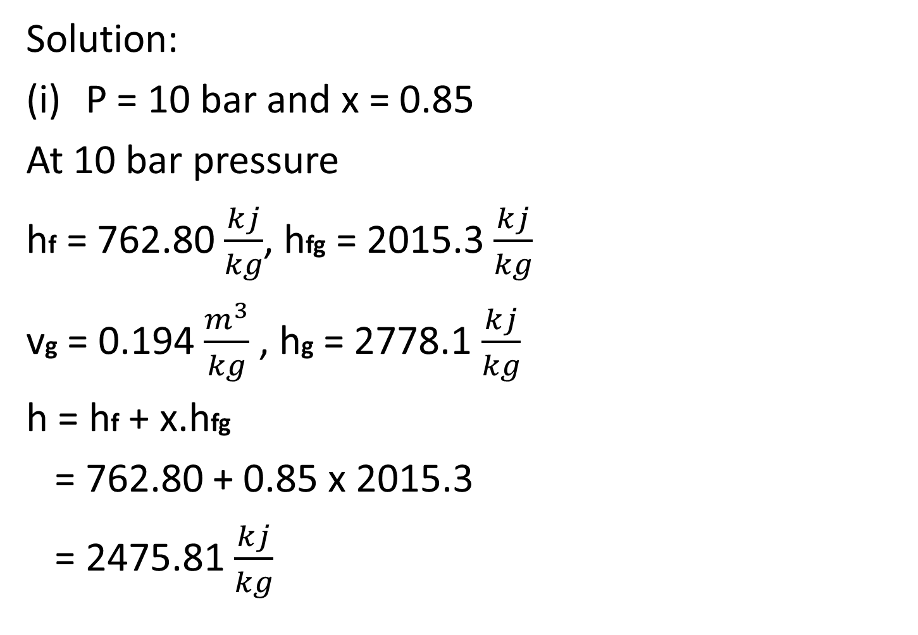
Solution:
P = 10 bar and x = 0.85
At 10 bar pressure
hf = 762.80 $\frac{kj}{kg}$, hfg = 2015.3 $\frac{kj}{kg}$
vg = 0.194 $\frac{m^{3}}{kg}$ , hg = 2778.1 $\frac{kj}{kg}$
h = hf + x.hfg
= 762.80 + 0.85 x 2015.3
= 2475.81 $\frac{kj}{kg}$

Slide 87

u = h – pv
= h –p(x.vg)
= 2475.81 – 10 x 100 x 0.85 x 0.194
= 2310.91 $\frac{kj}{kg}$

Slide 88

(ii) Dry and Saturated steam
h = hg = 2778.1 $\frac{kj}{kg}$
u = ug
= hg – pvg
= 2778.1 – 10 x 100 x 0.194
= 2584.1 $\frac{kj}{kg}$

Slide 89
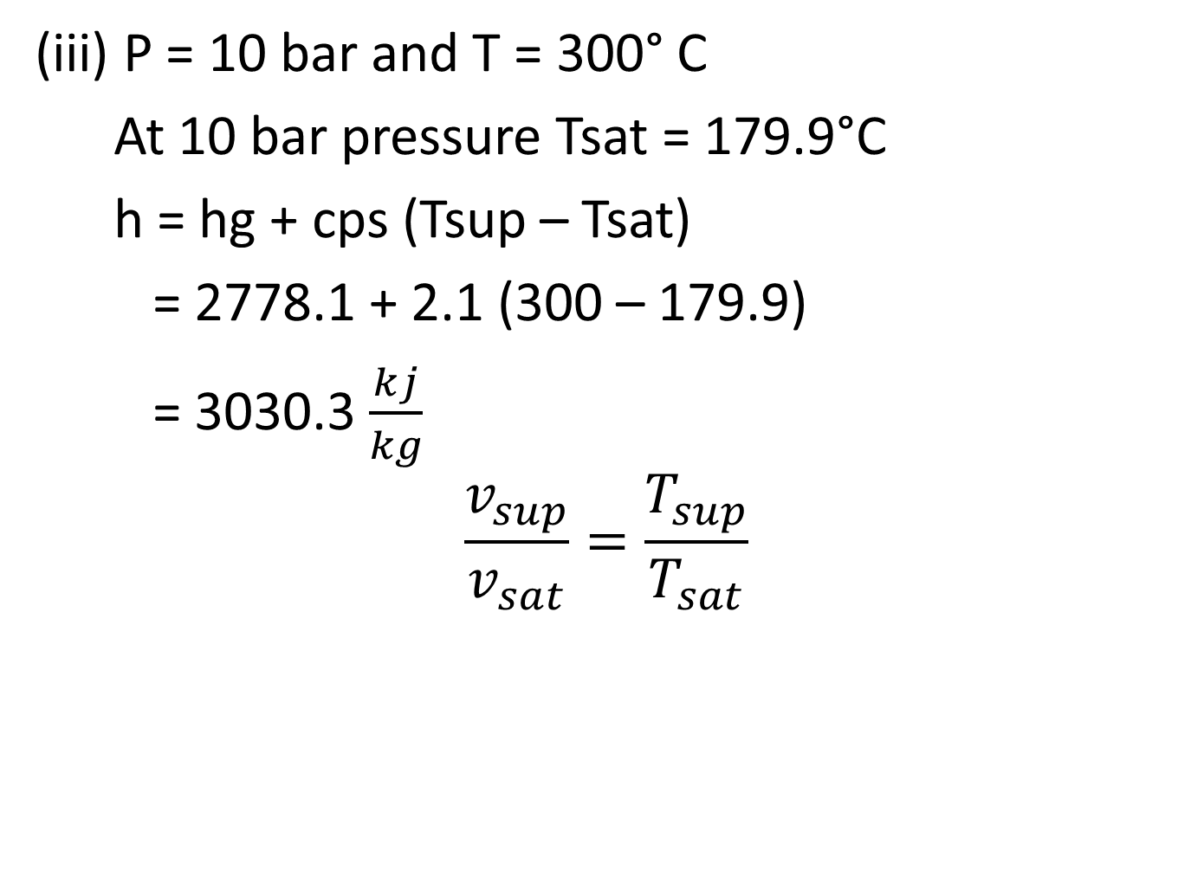
(iii) P = 10 bar and T = 300° C
At 10 bar pressure Tsat = 179.9°C
h = hg + cps (Tsup – Tsat)
= 2778.1 + 2.1 (300 – 179.9)
= 3030.3 $\frac{kj}{kg}$
$$\frac{v_{sup}}{v_{sat}}=\frac{T_{sup}}{T_{sat}}$$

Slide 90

$$\frac{v_{sup}}{v_{sat}}=\frac{T_{sup}}{T_{sat}}$$
vsup = $\frac{T_{sup}}{T_{sat}}$ . vsat
= $\frac{573}{452.9}$ . 0.194
= 0.246 $\frac{m^{3}}{kg}$
u = h – pv
= 3030.3 – 10 x 100 x 0.246
= 2784.3 $\frac{kj}{kg}$

Slide 91
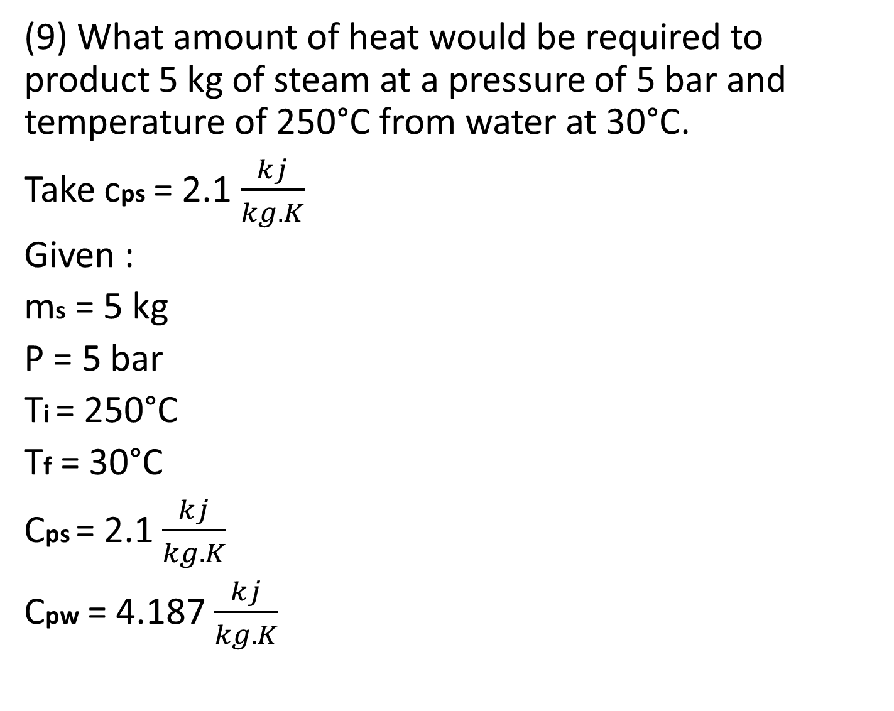
(9) What amount of heat would be required to product 5 kg of steam at a pressure of 5 bar and temperature of 250°C from water at 30°C.
Take cps = 2.1 $\frac{kj}{kg.K}$
Given :
ms = 5 kg
P = 5 bar
Ti = 250°C
Tf = 30°C
Cps = 2.1 $\frac{kj}{kg.K}$
Cpw = 4.187 $\frac{kj}{kg.K}$

Slide 92
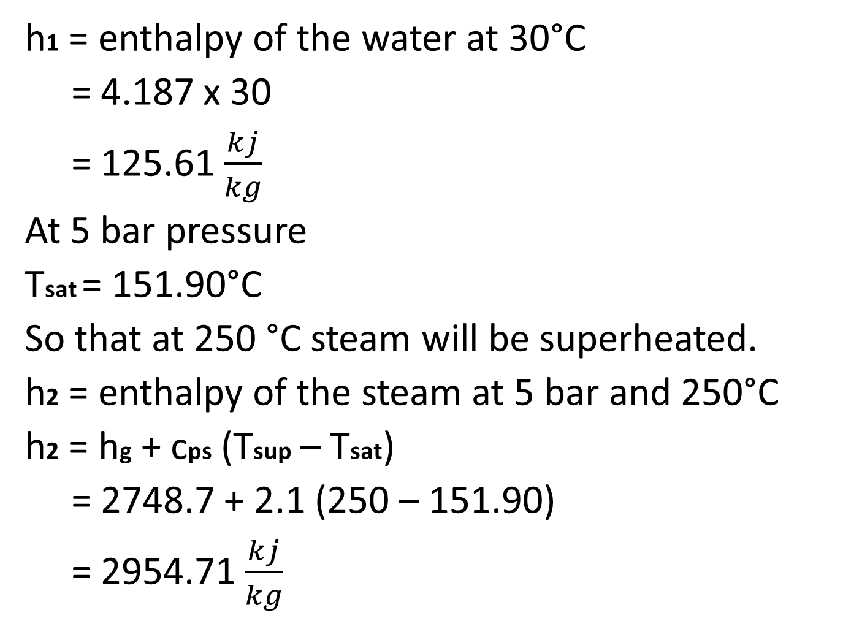
h1 = enthalpy of the water at 30°C
= 4.187 x 30
= 125.61 $\frac{kj}{kg}$
At 5 bar pressure
Tsat = 151.90°C
So that at 250 °C steam will be superheated.
h2 = enthalpy of the steam at 5 bar and 250°C
h2 = hg + cps (Tsup – Tsat)
= 2748.7 + 2.1 (250 – 151.90)
= 2954.71 $\frac{kj}{kg}$

Slide 93
Amount of the heat required to produce 5 kg of the steam will be
= ms (h2 – h1)
= 5 x (2954.71 – 125.61)
= 14145.5 kj

Slide 94

(10) How much of the heat is required to convert 3 kg 0f water at 30°C in to steam at 8 bar and 210 °C ? Take specific heat of superheated steam as 2.1 $\frac{kj}{kg.K}$ and that of water as 4.186 $\frac{kj}{kg.K}$.
Given:-

Slide 95

ms = 3 kg
Tf = 30°C
P = 8 bar
Ti = 210 °C
Cps = 2.1 $\frac{kj}{kg.K}$
Cpw = 4.186 $\frac{kj}{kg.K}$
h1 = enthalpy of the water at 30°C
= 4.186 x 30
= 125.58 $\frac{kj}{kg}$

Slide 96

At 8 bar Tsat = 170.4°C
So at 210°C steam will be superheated.
h2 = enthalpy of the steam at 8 bar and 210°C
= hg + cps (Tsup – Tsat)
= 2769.1 + 2.1 (210 – 170.4)
= 2852.26 $\frac{kj}{kg}$

Slide 97
Amount of heat required to be added to convert 3 kg of water at 30°C in to steam at 8 bar and 210°C
= ms (h2 – h1)
= 3 (2852.2 – 125.58)
= 8180.04 kj

